Slide 1
Shyama Prasad Mukherji
Rurban Mission
SPMRM
RURBAN SPATIAL PLAN
Kamabadur Cluster, Andhra Pradesh
24th June 2019

Slide 2
CONTENT OF THE PRESENTATION
Spatial Plan Preparation Methodology
Plan Preparation Status
Planning Area Notification.
Regional Setting
Existing Land Use
Demand Gap Analysis & Projections
Spatial Plan
Issues and Recommendations

Slide 3
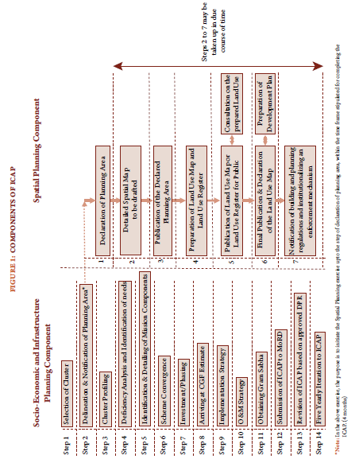
SPATIAL PLAN PREPARATION METHODOLOGY
Master Plans expected out put mentioned in ICAP
Role of DTCP
The Planning area needs to be distinctively shown on the map with GIS co-ordinates on a scale of 1:8000.
ii. Planning areas shall as far as possible
include full plot nos. (Survey Nos).

Slide 4
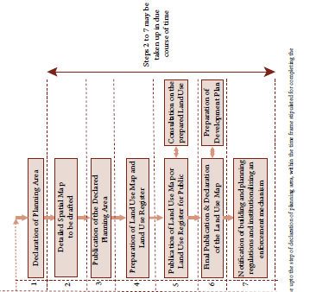
SPATIAL PLAN PREPARATION METHODOLOGY IN ANDHRA PRADESH
Base Map preparation
Carried by Panchayat Raj Dept.
Field/Ground Truthing
Stakeholder meeting
Existing Land Use Map Preparation
Land use Proposals
DTCP Role
Preliminary Draft Master Plan with Regulations
Stakeholder meeting
Draft GIS based Master Plans with Regulations.
Submission of Draft Master Plan with Report to Govt
Preparation of Draft GIS based Master Plan
Assistance to Panchayat Raj Dept. in draft notification

Slide 5
SPATIAL PLAN PREPARATION METHODOLOGY IN ANDHRA PRADESH - IN DETAIL
Kickoff Meeting
2days
Primary and Secondary data Collection
Goals, Objective & Guiding Principles
Inception Report
9 days
Existing Situation Assessment
Inception cum Site Assessment
Existing Situation Assessment Report
Land Use survey
Transport Survey
Socio-economic survey
22 days
Preparation of Base map
Field & Traffic Survey Analysis Report
37 Days
Workshop – I (Stakeholder Meeting)
47 Days
Vision-2041
and
Strategy Formulation
Concept report and Map
Land suitability, SWOT Analysis, Issues
Vision & Strategy Formulation report
52 Days
Demand Assessment - & Demographic Projections
Demography
Land Use
Physical Infrastructure
Transport
Investment Strategies
Commerce Tourism
Preliminary Proposal Plan
Preliminary Draft Master Plan Report
67 Days
Preliminary Draft Master Plan
Proposed Land Use Plan
Workshop – II (Stakeholder meeting)
Draft GIS based Master Plans with Zoning
Regulations.
Feedback from Workshop II
Proposed Land Use Plan
Draft Master Plan Report
GIS based Master Plan & Study maps
72 Days
Assistance to
PR&RD in notification
Finalization of Final
Draft GIS based Master Plans
Final Master Plan & Report to Govt.
142 Days
162 Days
172 days

Slide 6
PLANNING AREA NOTIFICATION & CURRENT STATUS
Out of 13 clusters RURBAN Clusters 11 clusters have been notified vide Proc.No.PRR02 -23036/44/2018-ASPC-PRRD Dated: 21-1-2019 of Director Panchayat Raj and Rural Development
Other two clusters i.e Rampachodavaram and Eluru are yet to be notified.
Panchayat Raj Department
DTCP
The State Level Empowered Committee (SLEC) has given approval for issue of Planning Area Notification for 11 Clusters
DTCP has Georeferenced and digitized all 11 Cluster boundaries in GIS.
DTCP has also Geo referenced and digitized the remaining two clusters.
The Gram Panchayats which are part of the Rurban Cluster have passed resolutions for delineation and notification of their Gram Panchayats as Planning area under NRuM (Rurban Mission).
DTCP has sent 13 Cluster Boundaries to NRSC for obtaining Satellite images.(Cartosat 2S with 0.6 Mts ) Resolution
Panchayat Raj has notified 11 Clusters and delineated the planning boundaries and the same has been shared with DTCP.
Kambadur Cluster - Landuse, Households and Traffic Surveys Completed and Landuse Map under Preparation

Slide 7
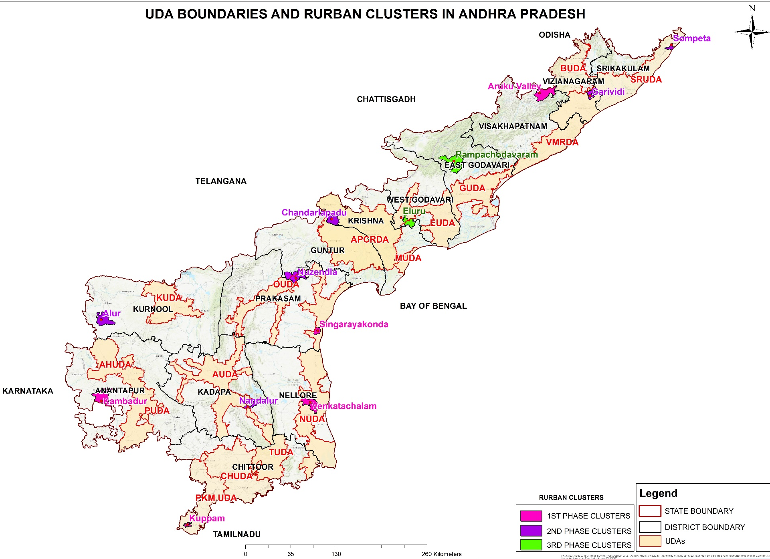
ANDHRA PRADESH RURBAN CLUSTERS
Sompeta, Garividi, Chandarlapadu, Singarayakonda, Venkatachalam, Kuppam Clusters are completely covered in UDAs
Nuzendila, Nandalur, Eluru Clusters are partially Covered in UDAs
Alur, Kambadur, Rampachodavaram, Araku Cluster are not covered in UDAs

Slide 8
PROFILE OF RURBAN CLUSTERS IN AP
S. No | Phase I (5) Clusters | AREA sq.km | Population 2011 | No of Gram Panchayats | No of Revenue Villages (s) | Village Settlements
1 | Araku valley (Visakhapatnam dist) | 162.88 | 56,674 | 11 | 102 | 173
2 | Kambadur (Ananthapur dist) | 397.4 | 50,799 | 12 | 12 | 42
3 | Kuppam (Chittoor dist) | 43.2 | 34,080 | 8 | 14 | 53
4 | Singarayakonda (Prakasam dist) | 75.1 | 27,691 | 7 | 6 | 23
5 | Venkatachalam (Nellore dist) | 260.4 | 61,275 | 18 | 16 | 72
Phase II (6) CLUSTERS
6 | Alur (Kurnool dist) | 301.7 | 14,426 | 11 | 11 | 17
7 | Sompeta (Srikakulam dist) | 62.9 | 18,778 | 11 | 13 | 25
8 | Chandarlapadu (Krishna dist) | 188.4 | 10,958 | 14 | 19 | 28
9 | Nandalur (YSR kadapa dist) | 112.8 | 5481 | 12 | 17 | 67
10 | Nuzendla ( Guntur dist) | 237.8 | 48,962 | 23 | 16 | 58
11 | Garividi (Vizinagaram dist) | 84.1 | 68,289 | 20 | 29 | 40
Under Phase – 3: Eluru and Rampachodavaram are covered which are yet to be notified

Slide 9
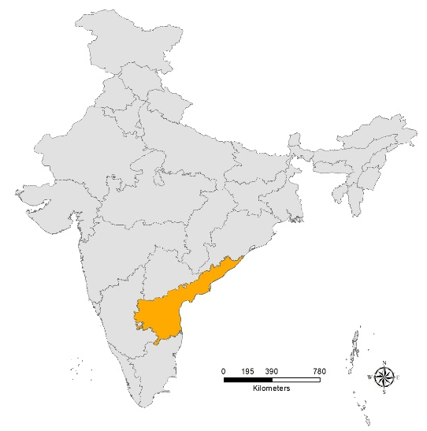
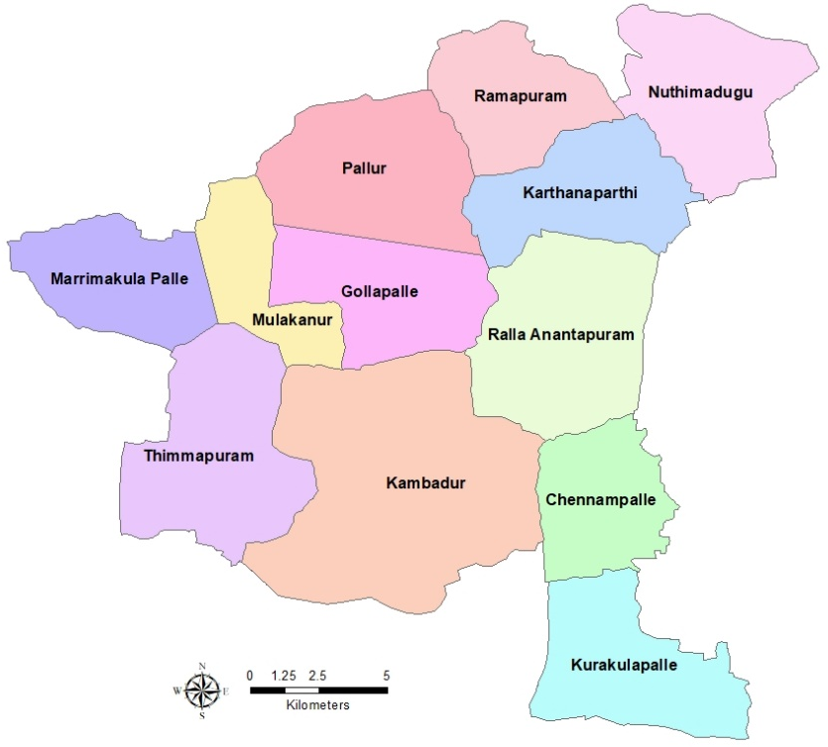
REGIONAL SETTING – KAMBADUR CLUSTER
ADMINISTRATIVE DIVISION OF ANANTHAPUR DISTRICT & LOCATION OF KAMBADUR CLUSTER
Kambadur Cluster Profile
Connectivity
Area: 397.4 Sqkm
Population:50,799
Males :25972
Females :24827
Sex Ratio :956
Households:11668
Population Density : 127.8 P/Sqkm
Literacy rate :60.48%
Kadiridevarapalli :9Km
Kalyanadurgam :30Km
Kalyanadurgam :30Km
Puttaparthi : 64Km
Source: Census of India, 2011 and Google Satellite Imagery

Slide 10
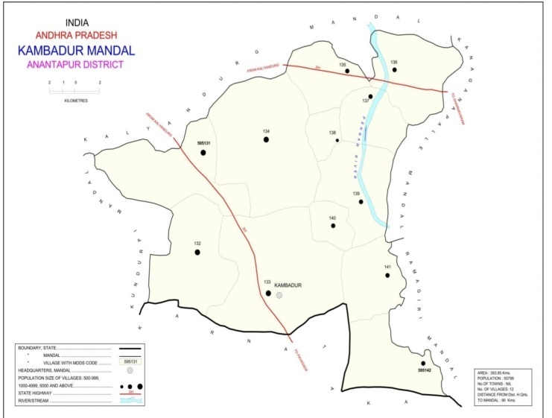
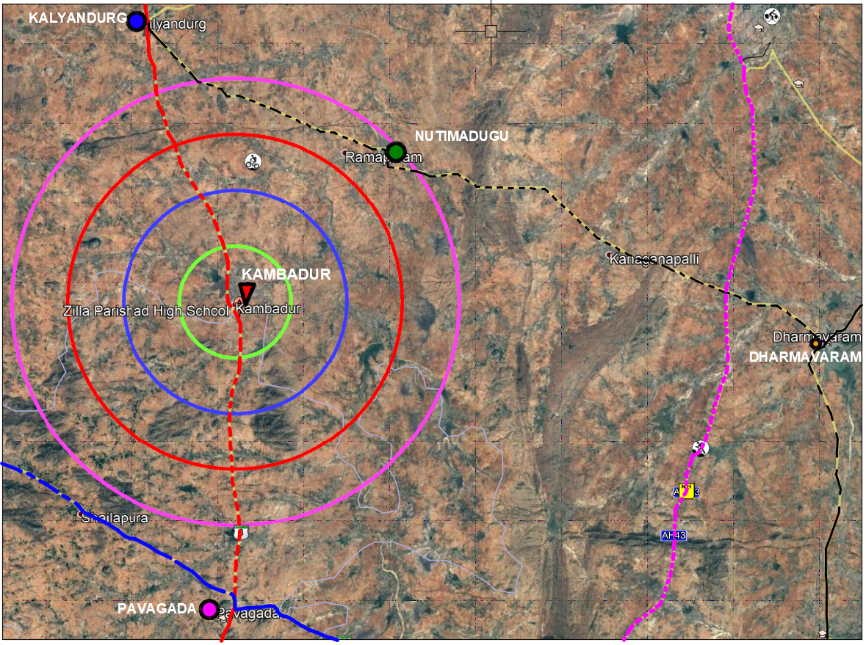
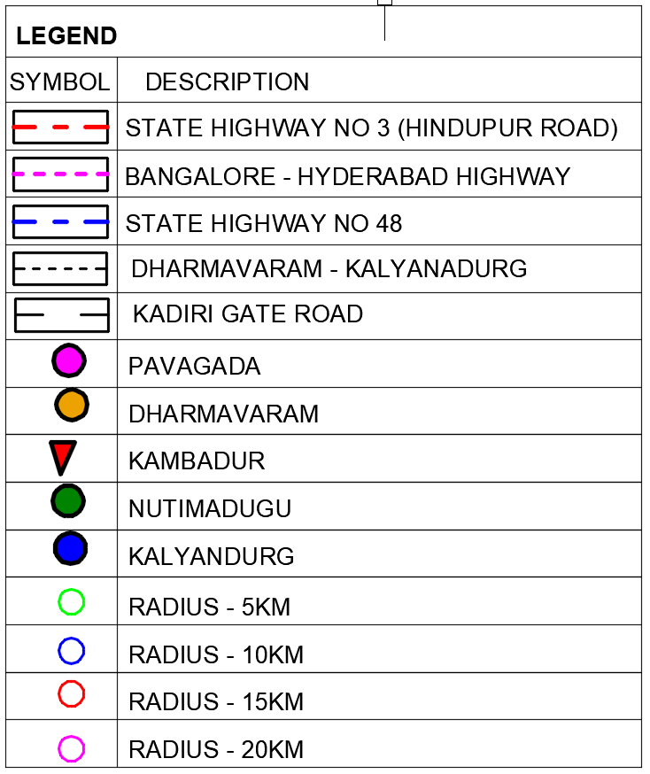
Regional Setting - Kambadur
SH
KARNATAKA
STATE
SH

Slide 11
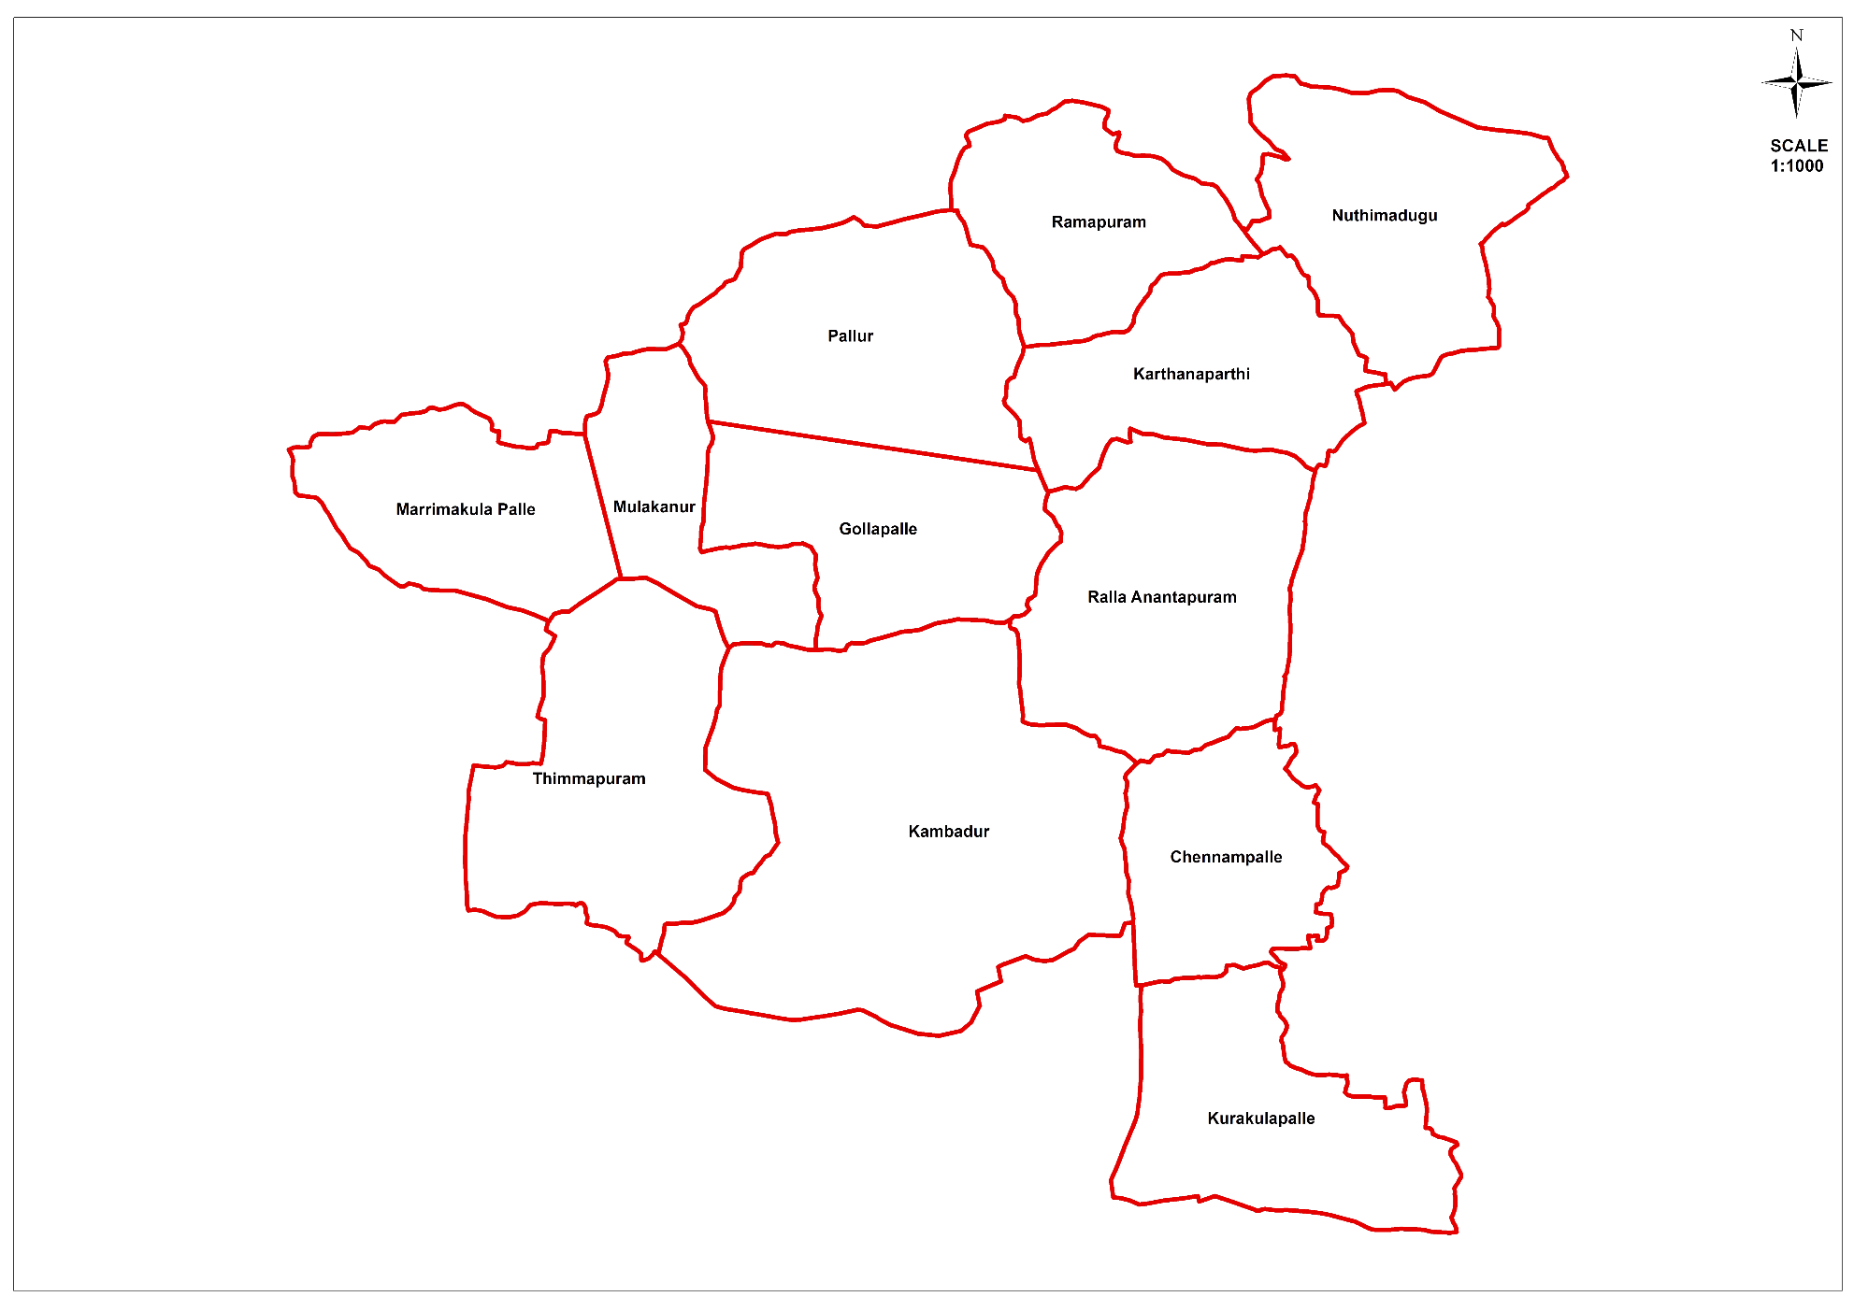
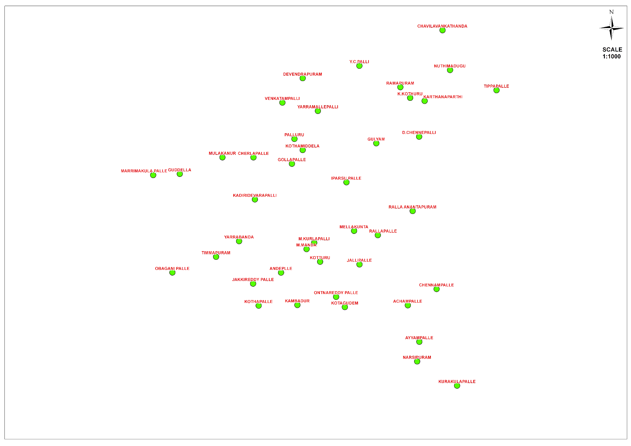
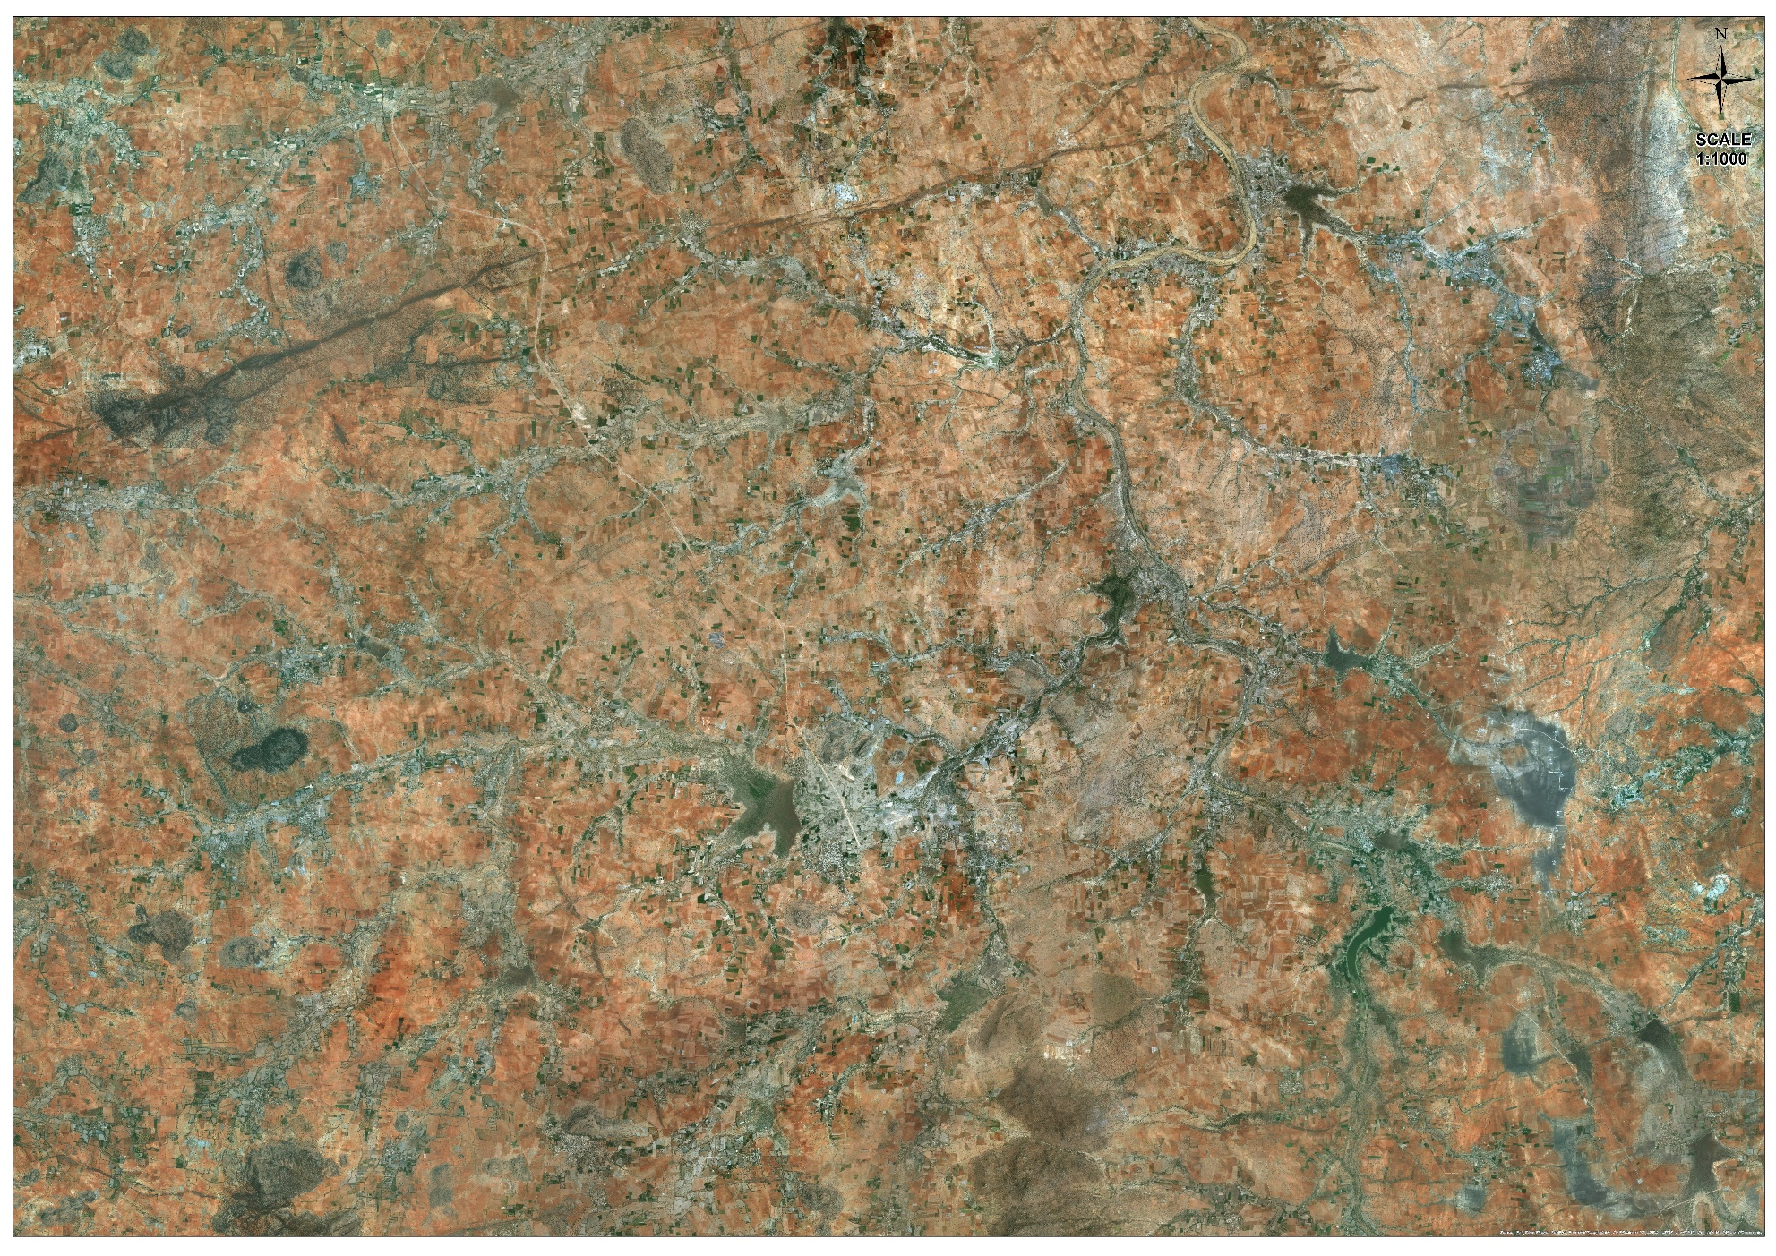
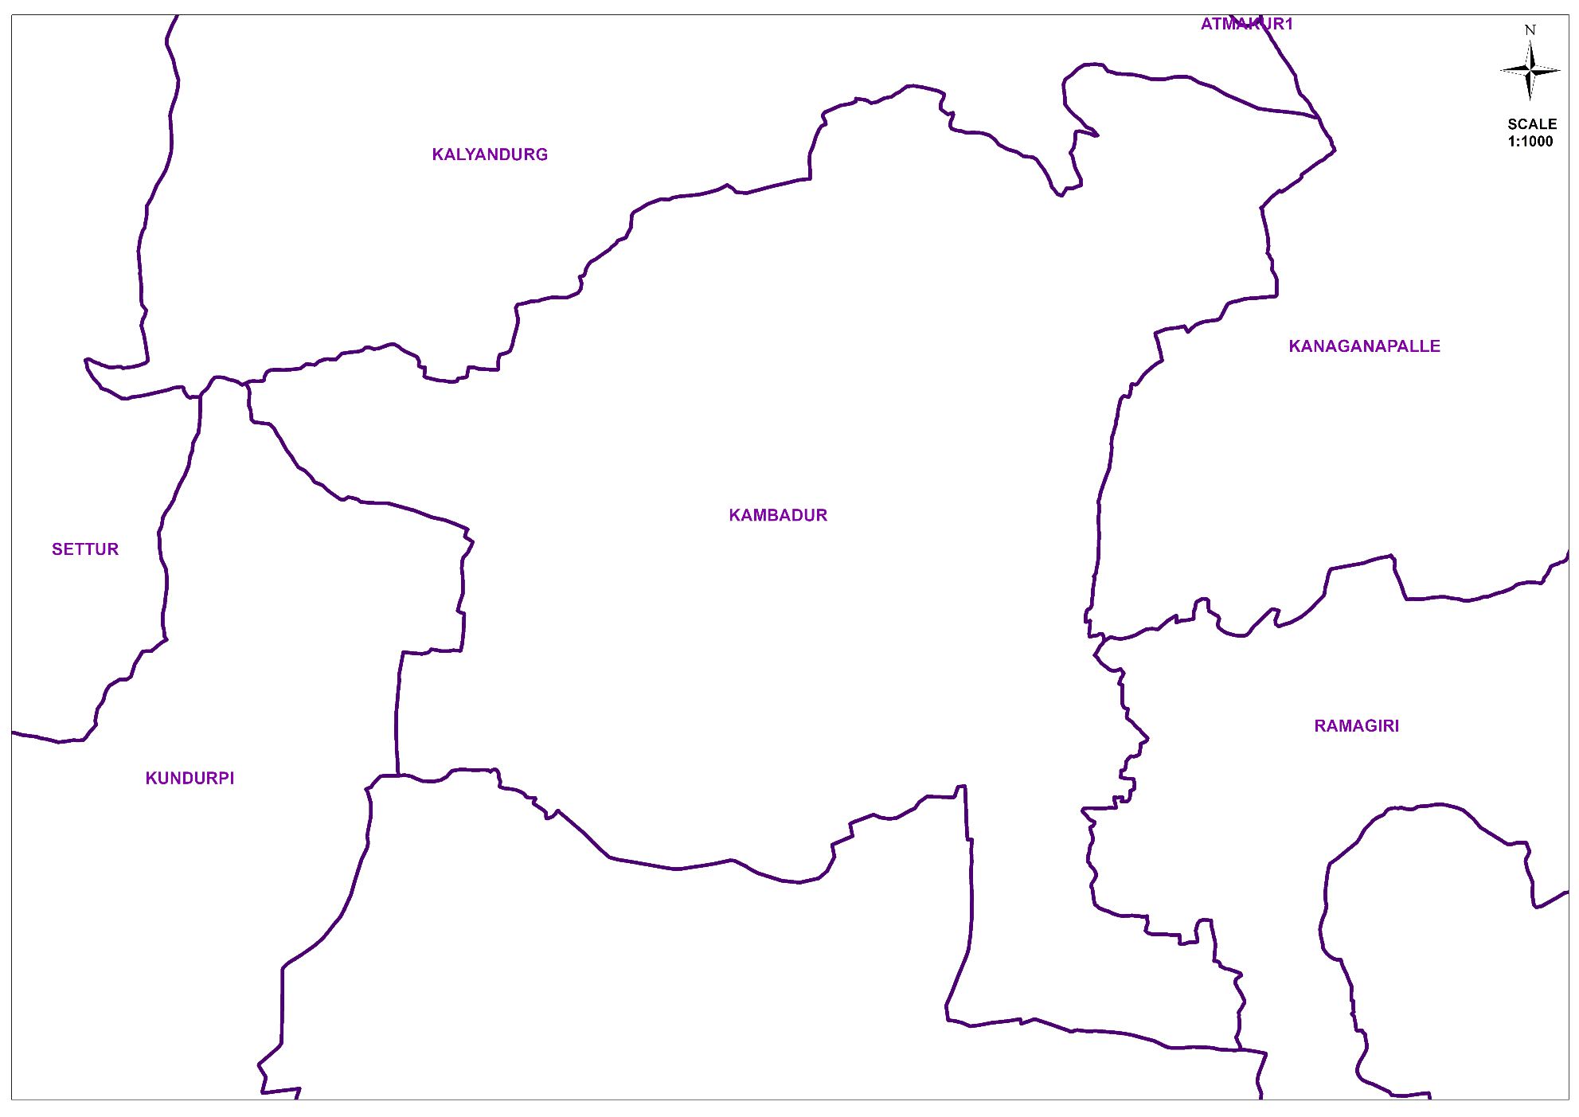
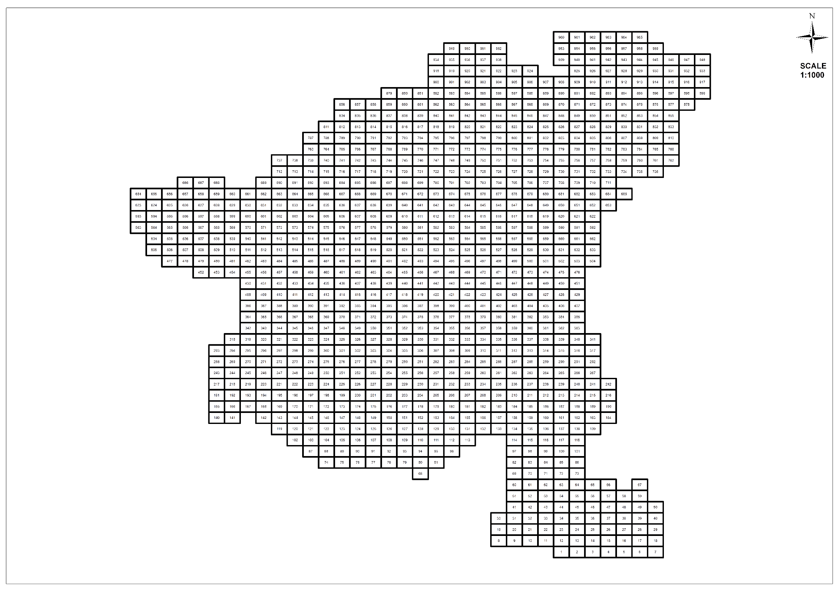
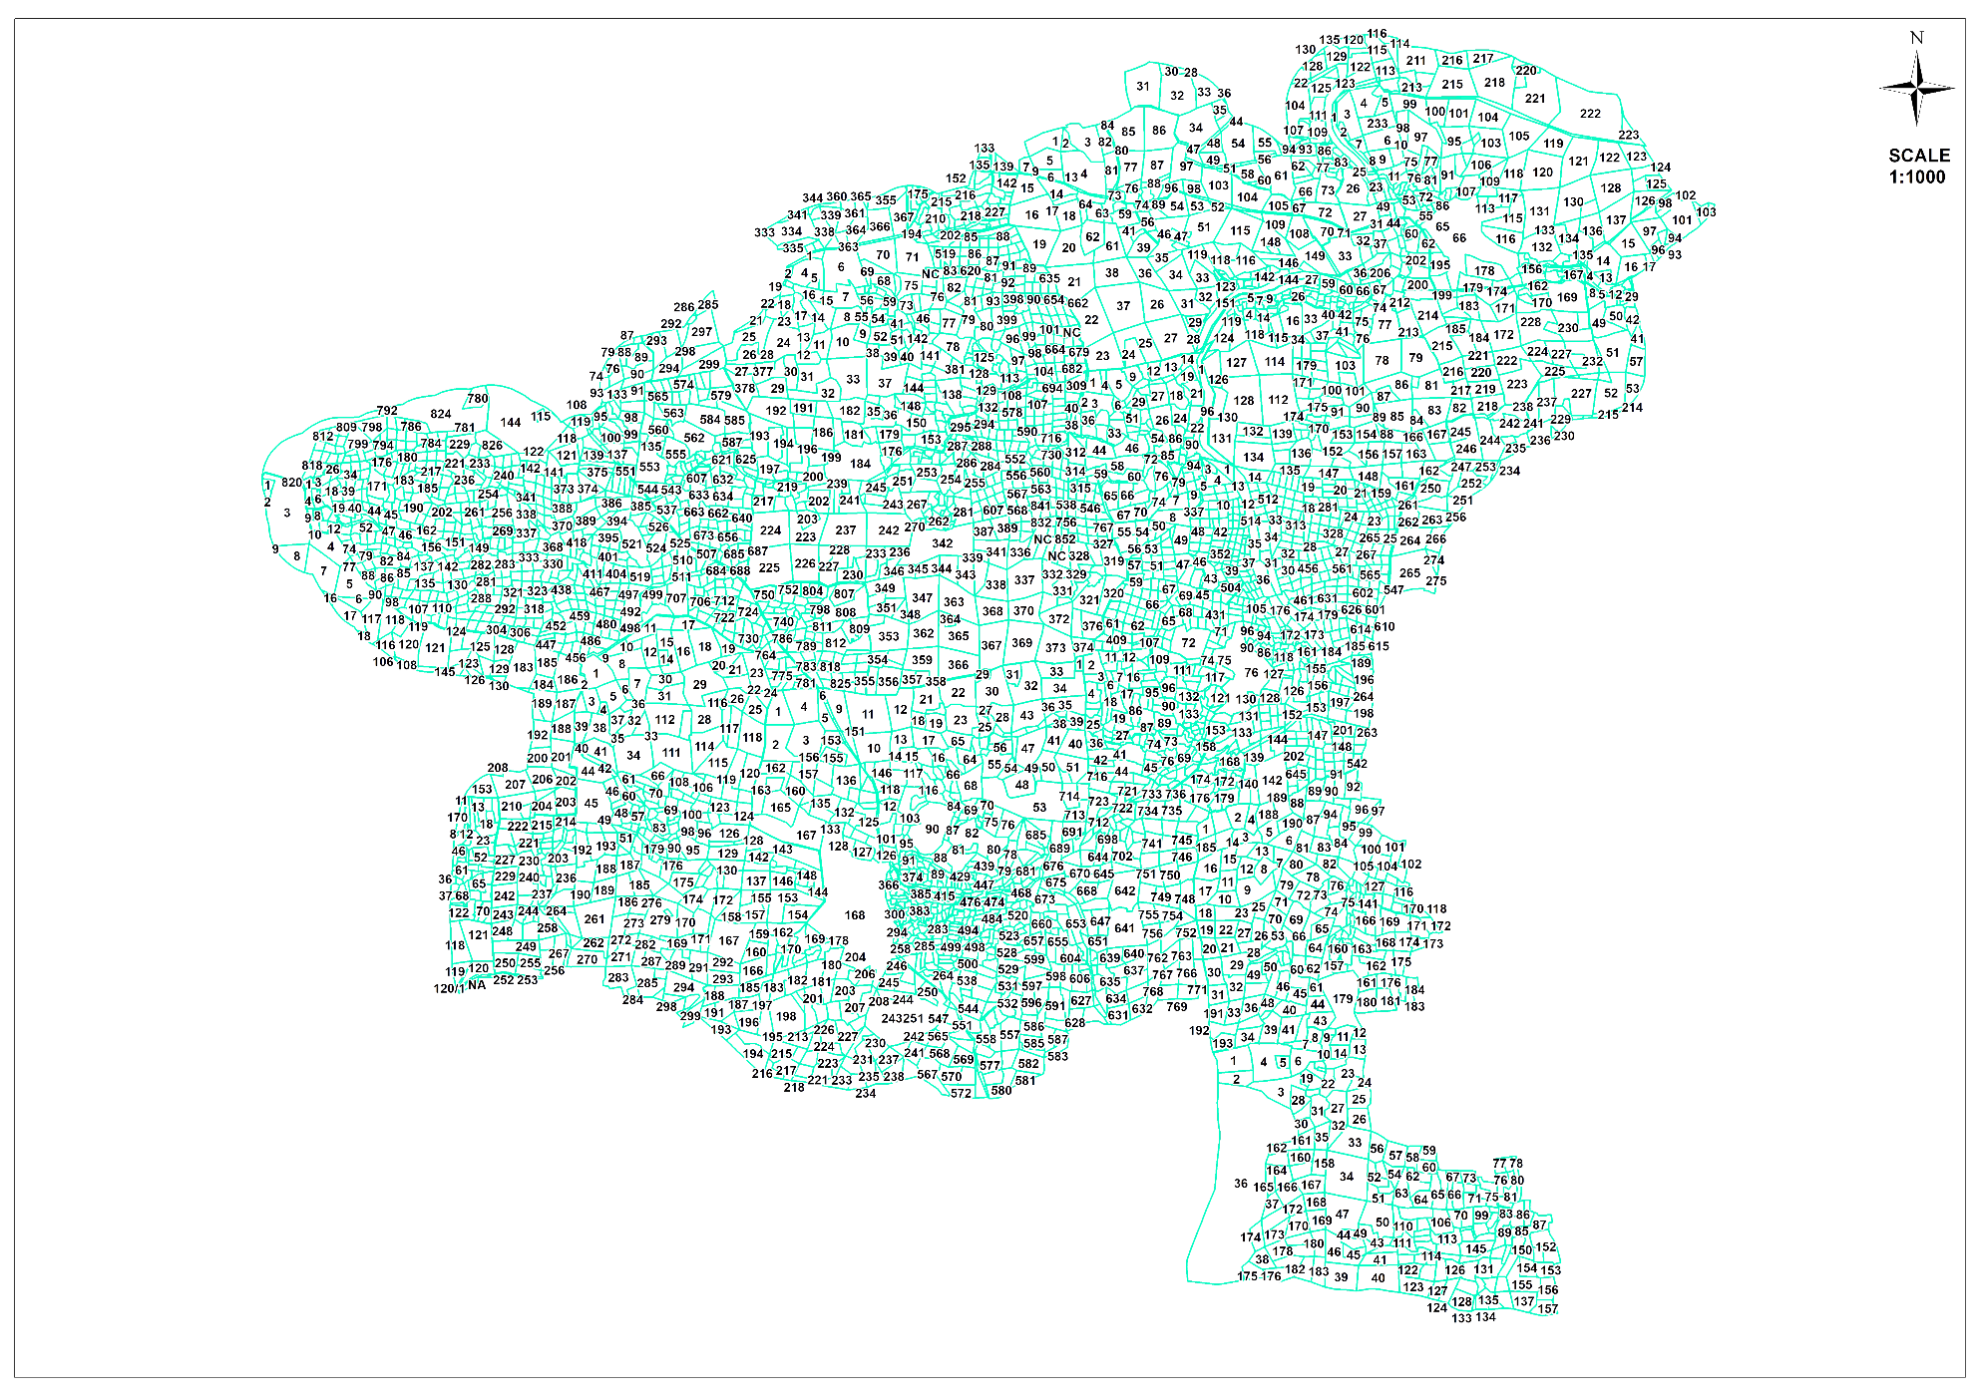
PROCESS OF PREPARATION OF LAND USE MAP
Kambadur Cluster 397 Sq.km
965 Grids of 1km x 1km
Cadastral Boundaries
12 Gram Panchayats
42 Habitations

Slide 12
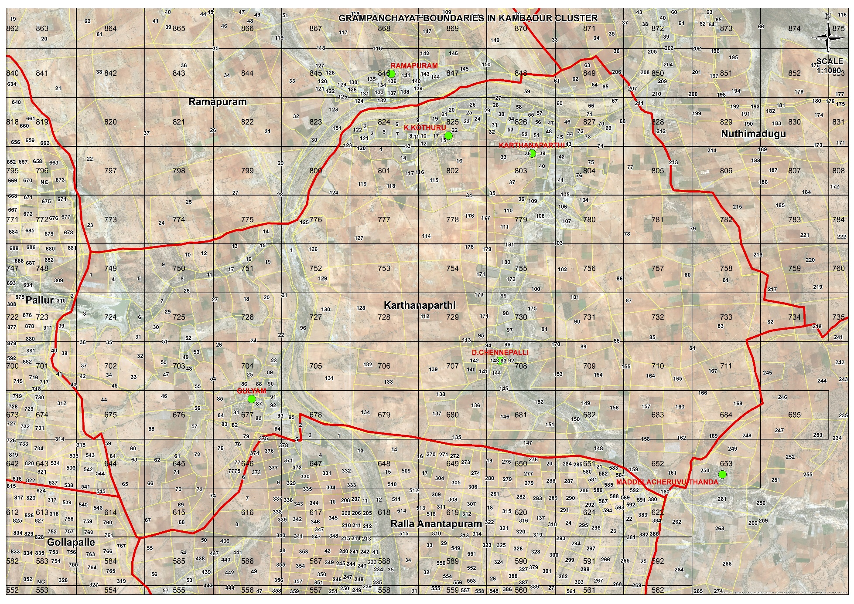
PROCESS OF PREPARATION OF LAND USE MAP

Slide 13
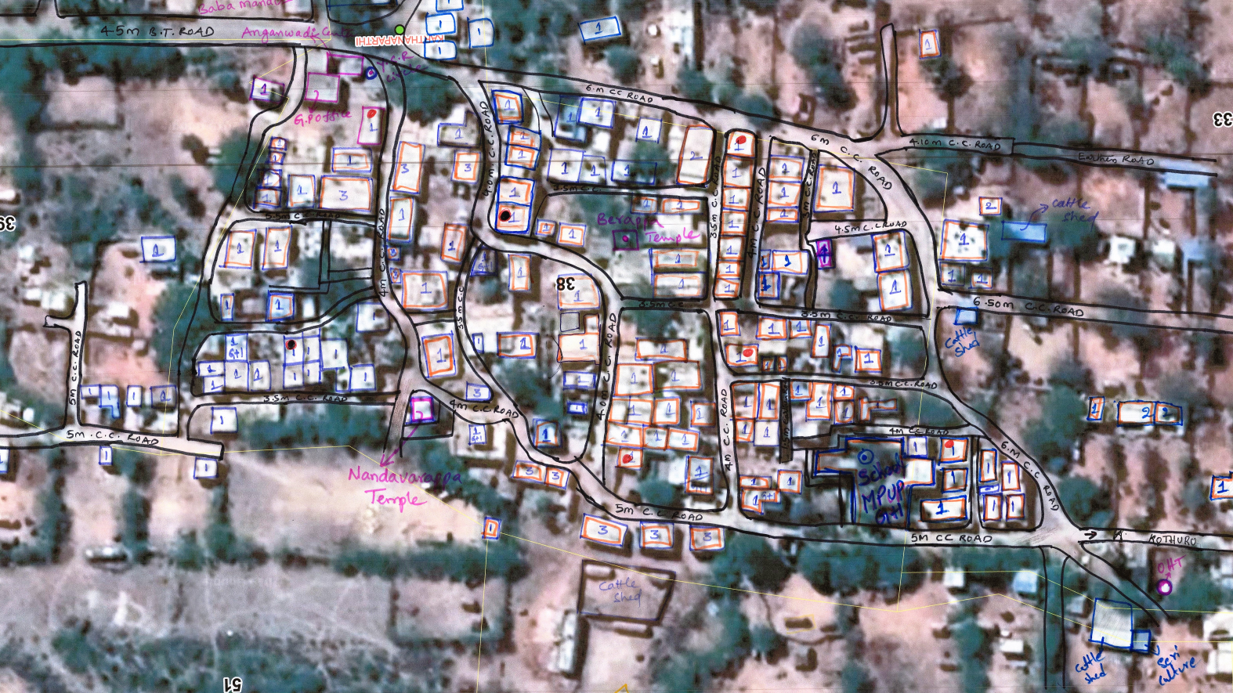
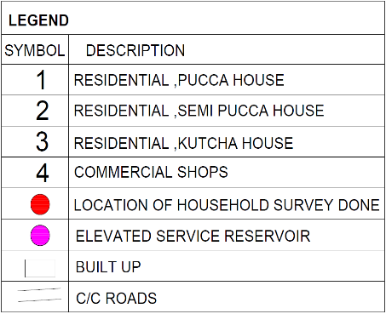
LANDUSE SURVEY(Ground Verification& Household surveys) -KARTHANAPARTHI (Kambadur Cluster)
N

Slide 14
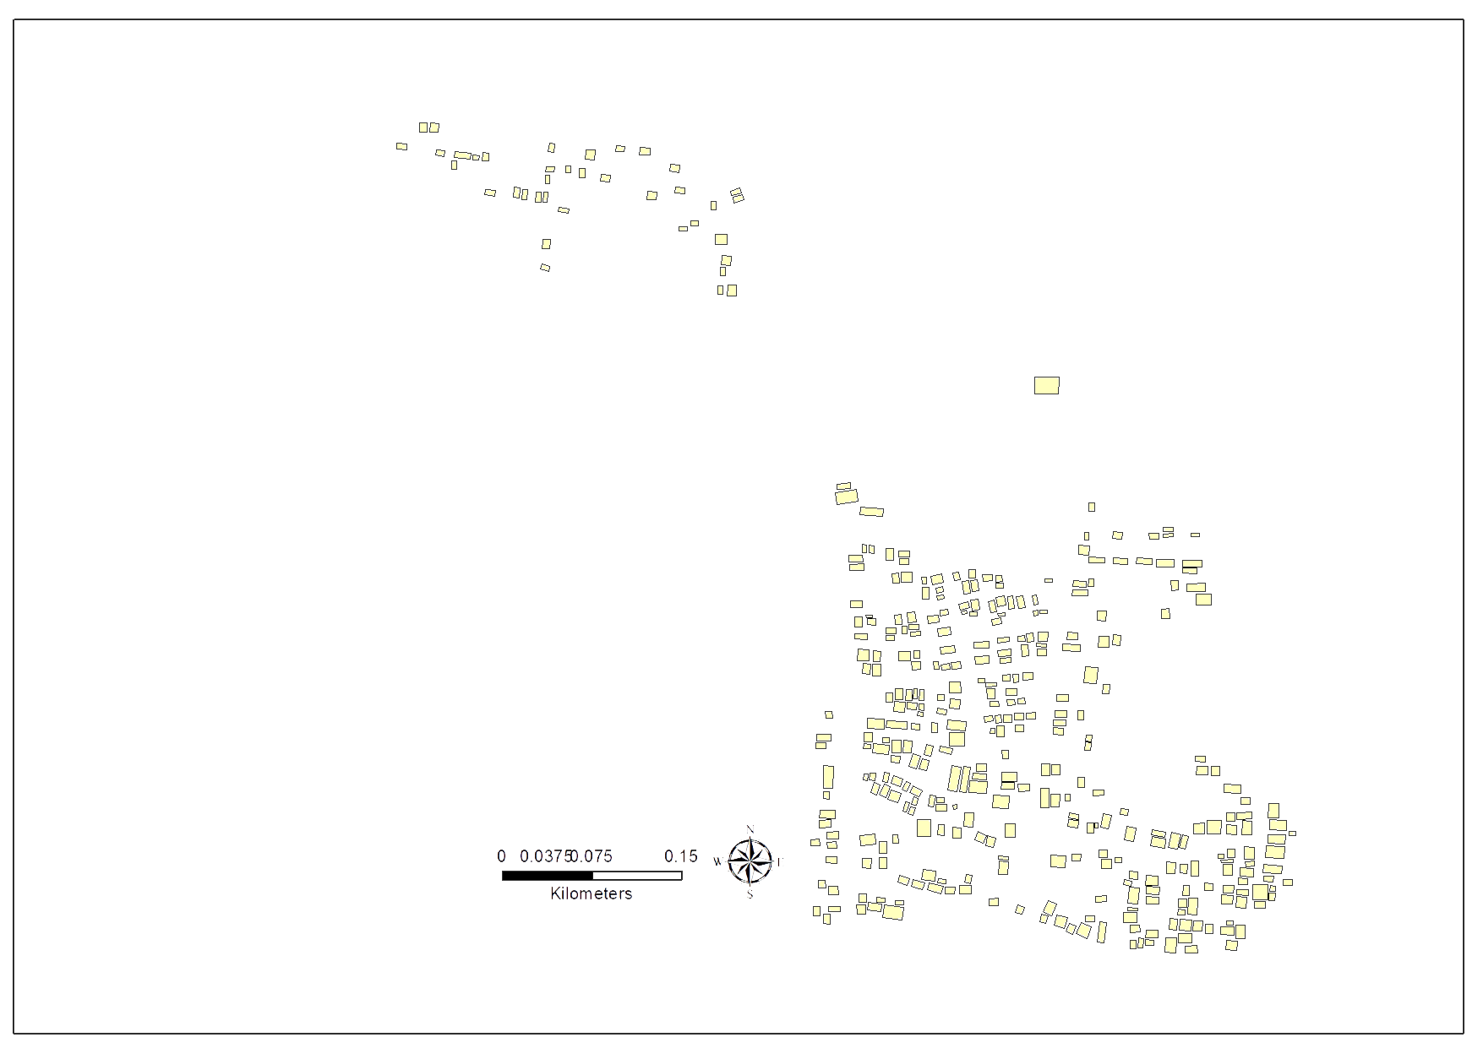
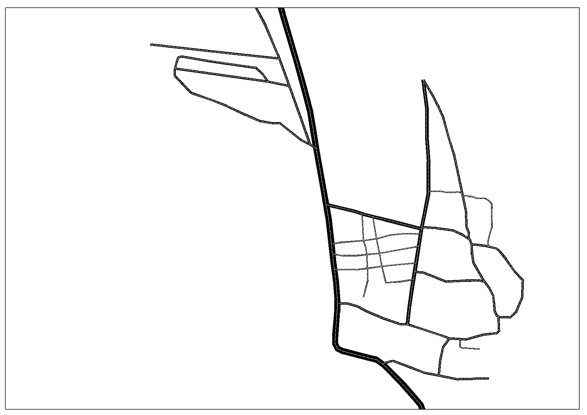
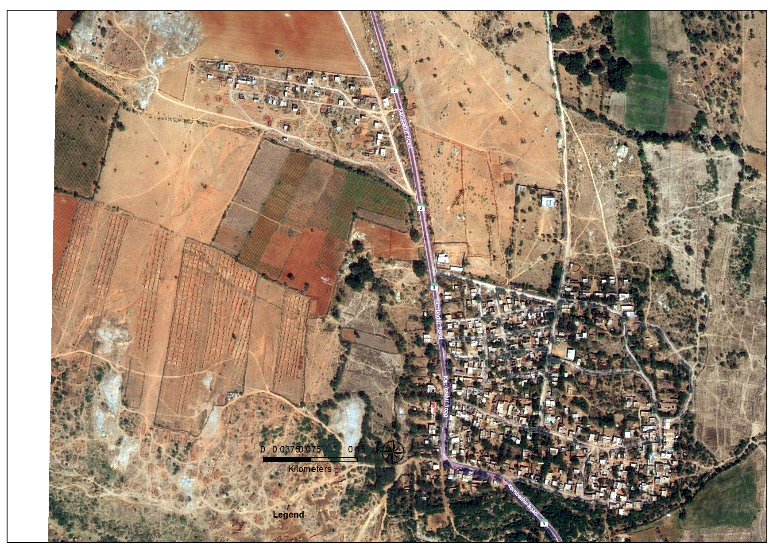
PREPARATION OF LAND USE MAP
Total No. of 367 House holds
Road Network of length 6.19 km

Slide 15
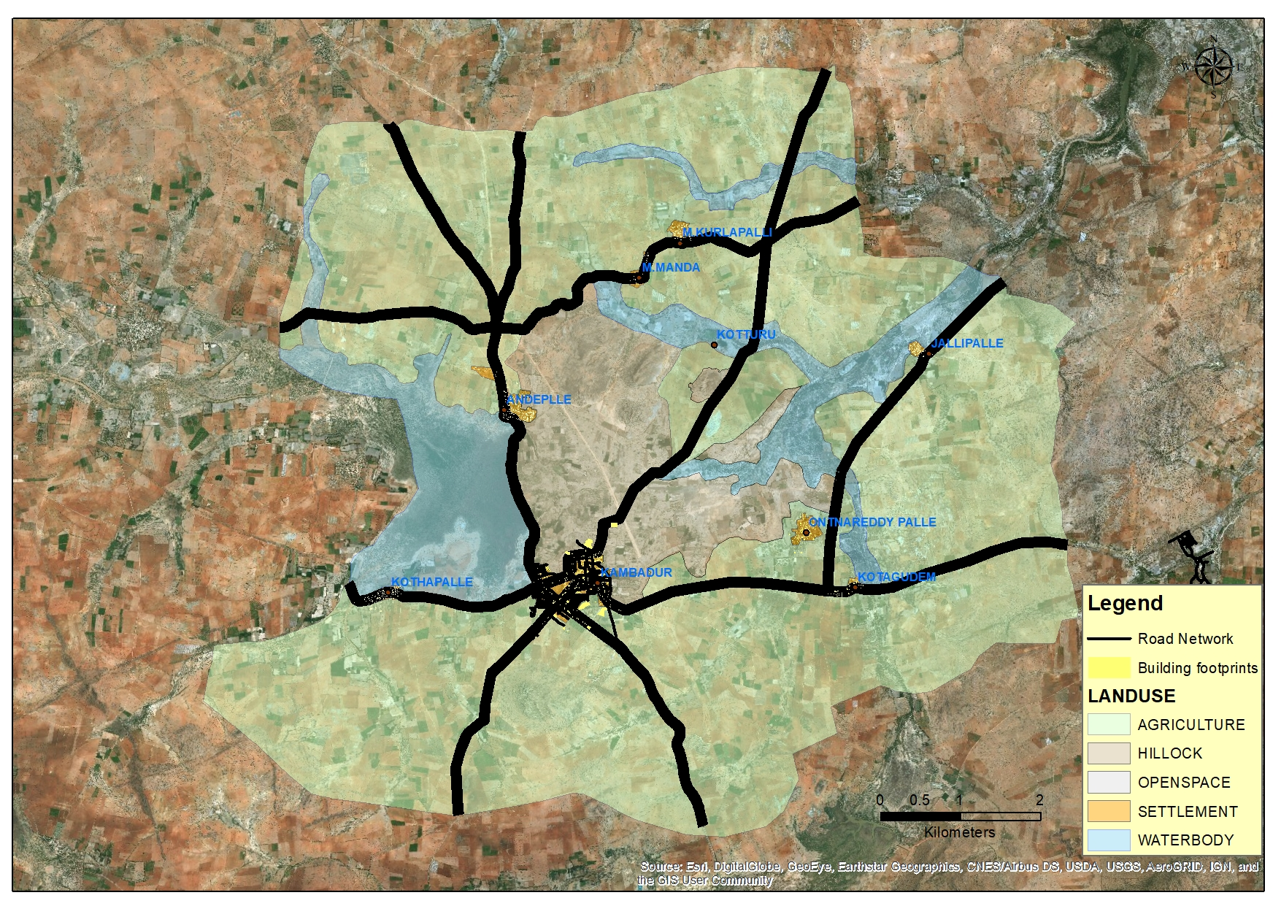
EXISTING LANDUSE MAP – Kambadur G.P

Slide 16
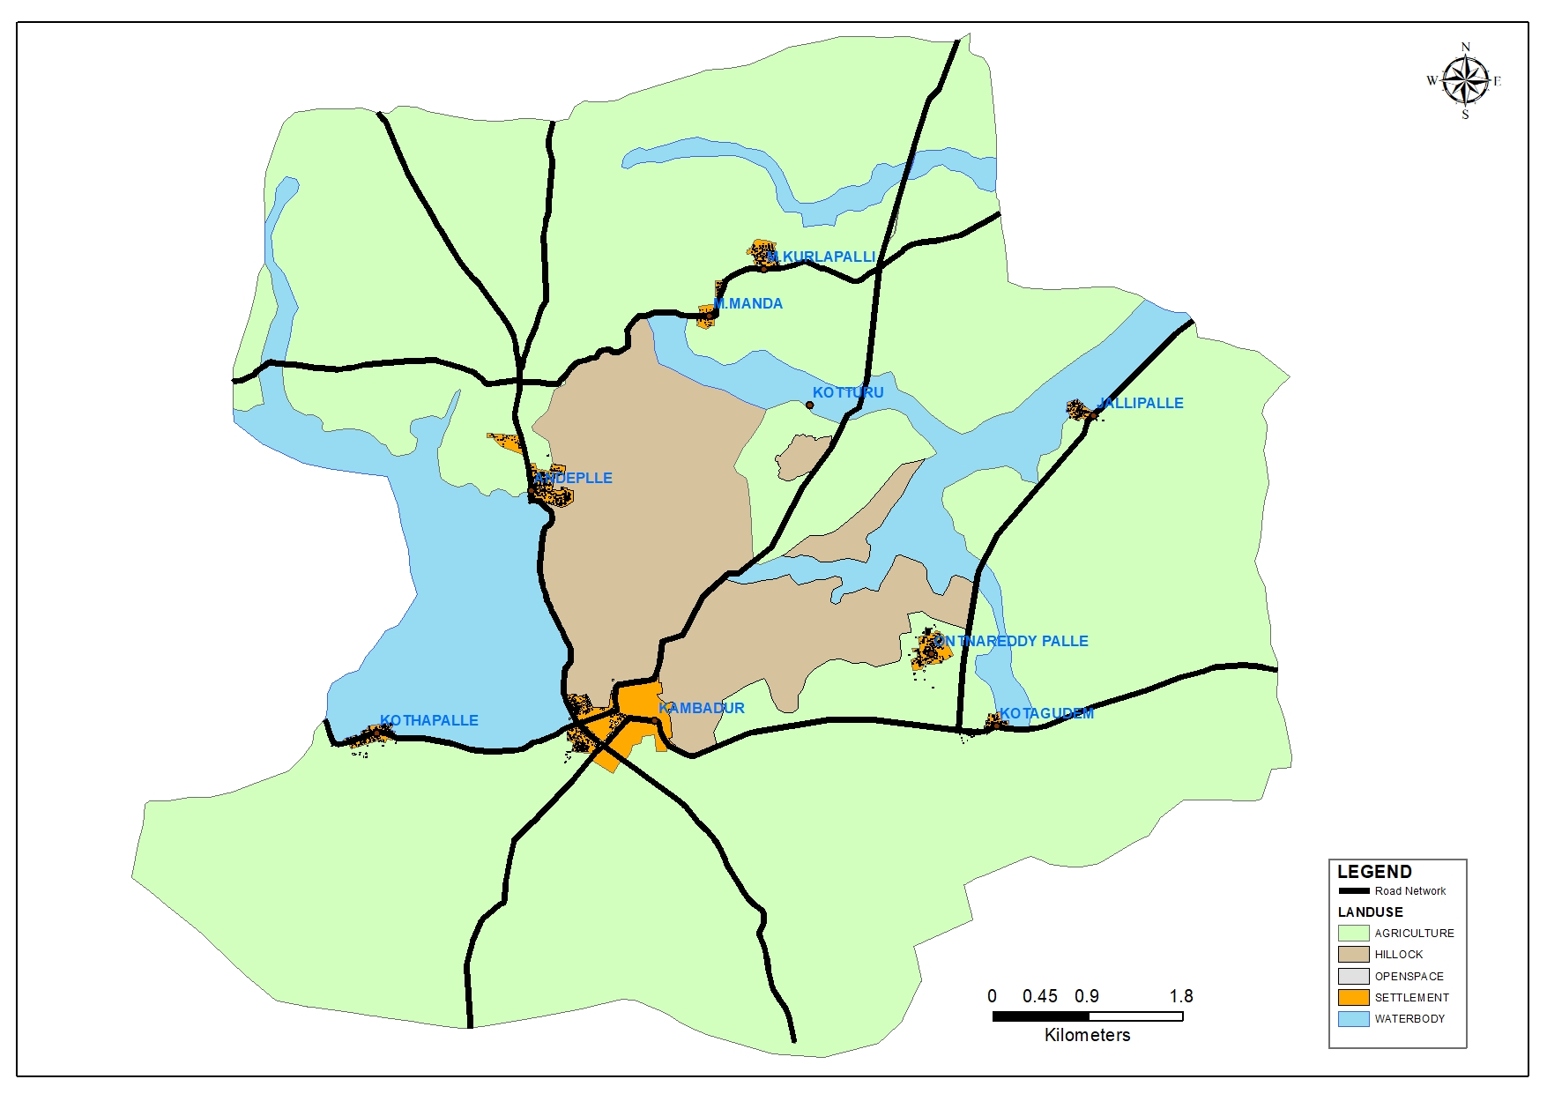
EXISTING LANDUSE MAP – Kambadur G.P

Slide 17
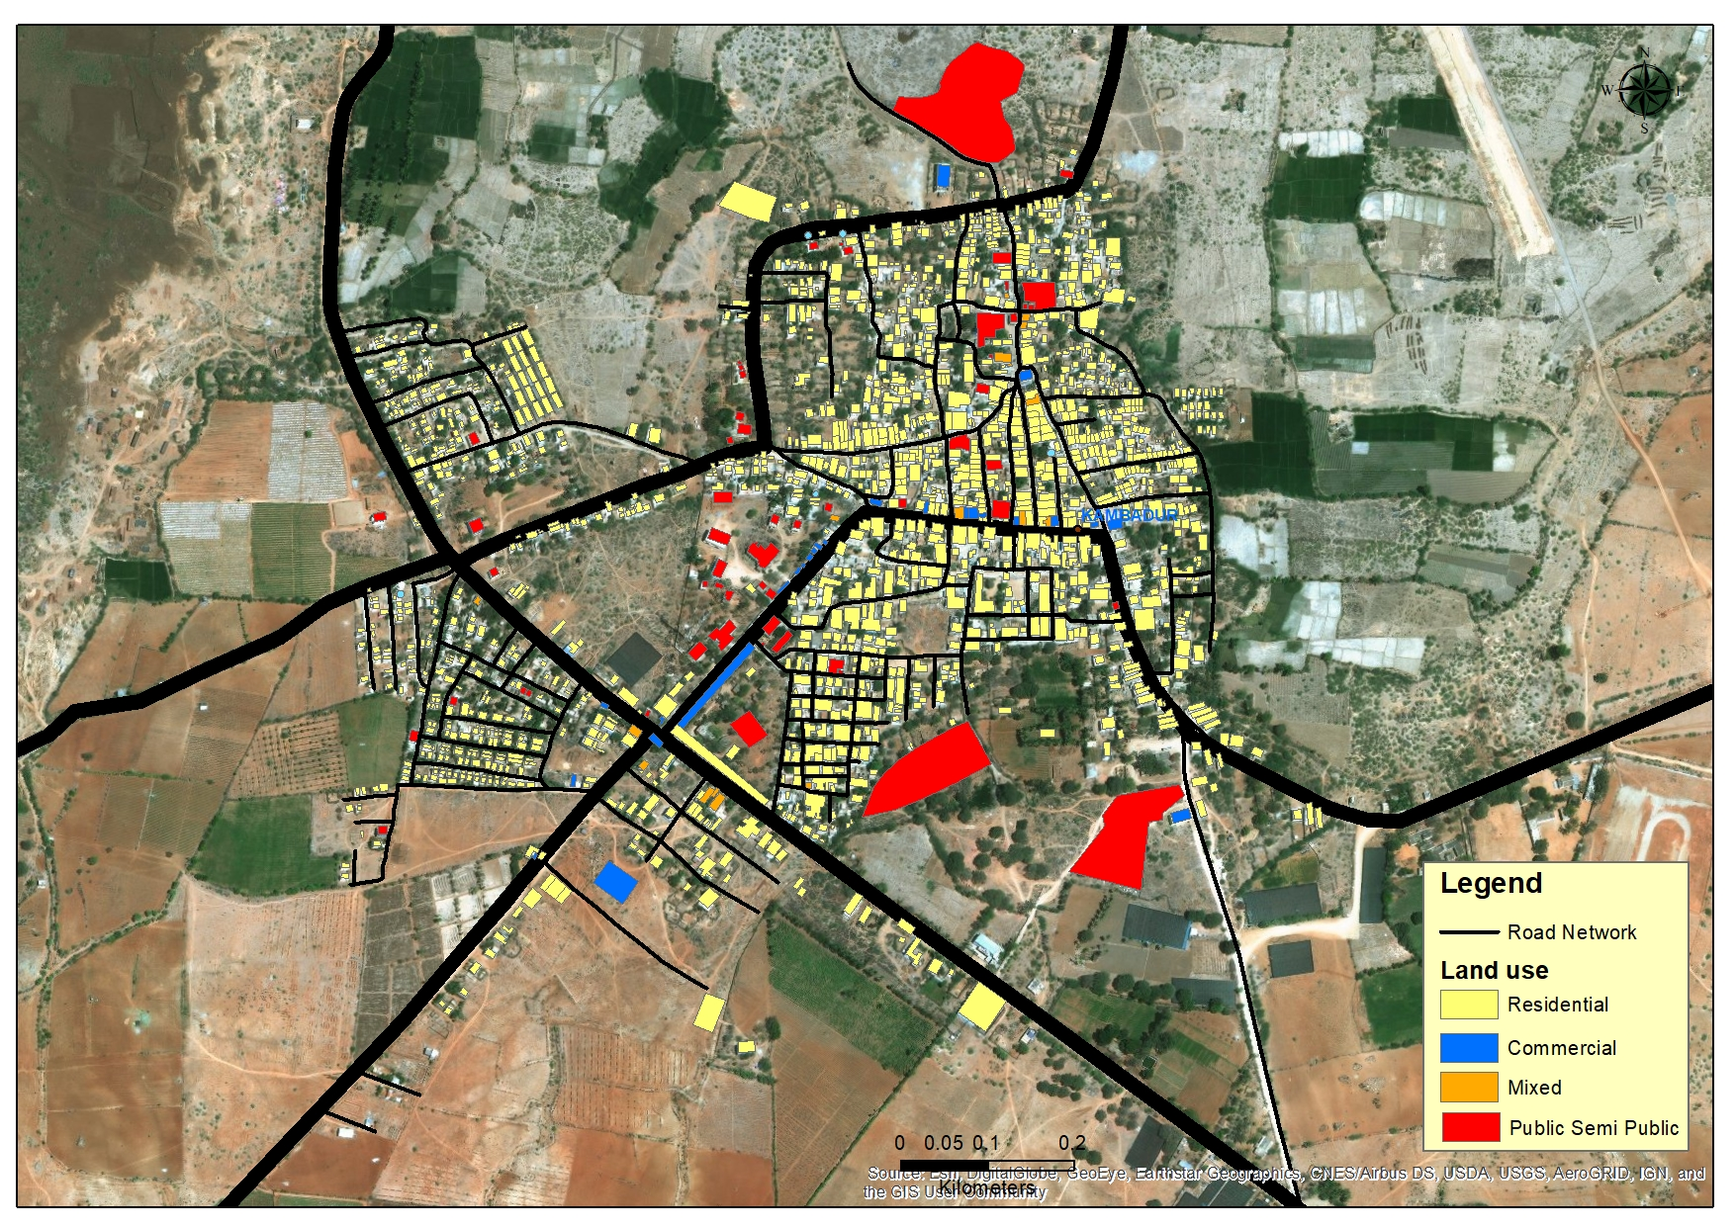
Existing Land Use map of Kambadur Habitation

Slide 18
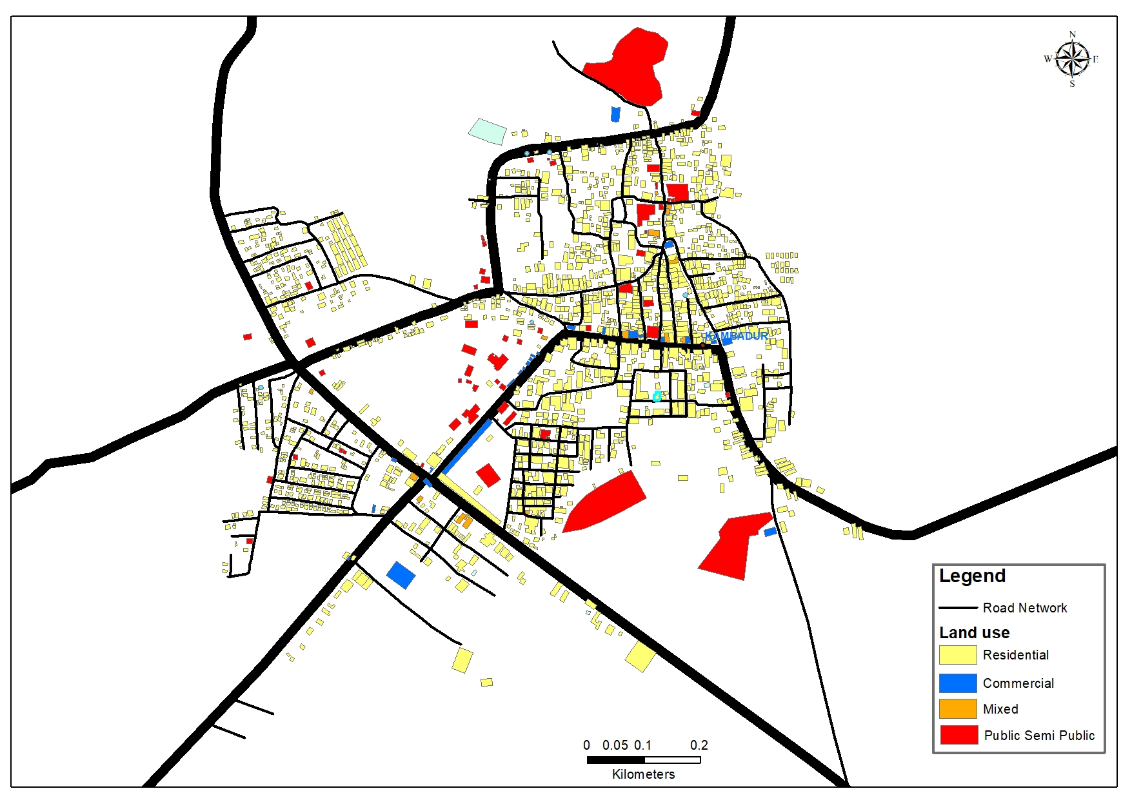
Existing Land Use map of Kambadur Habitation

Slide 19
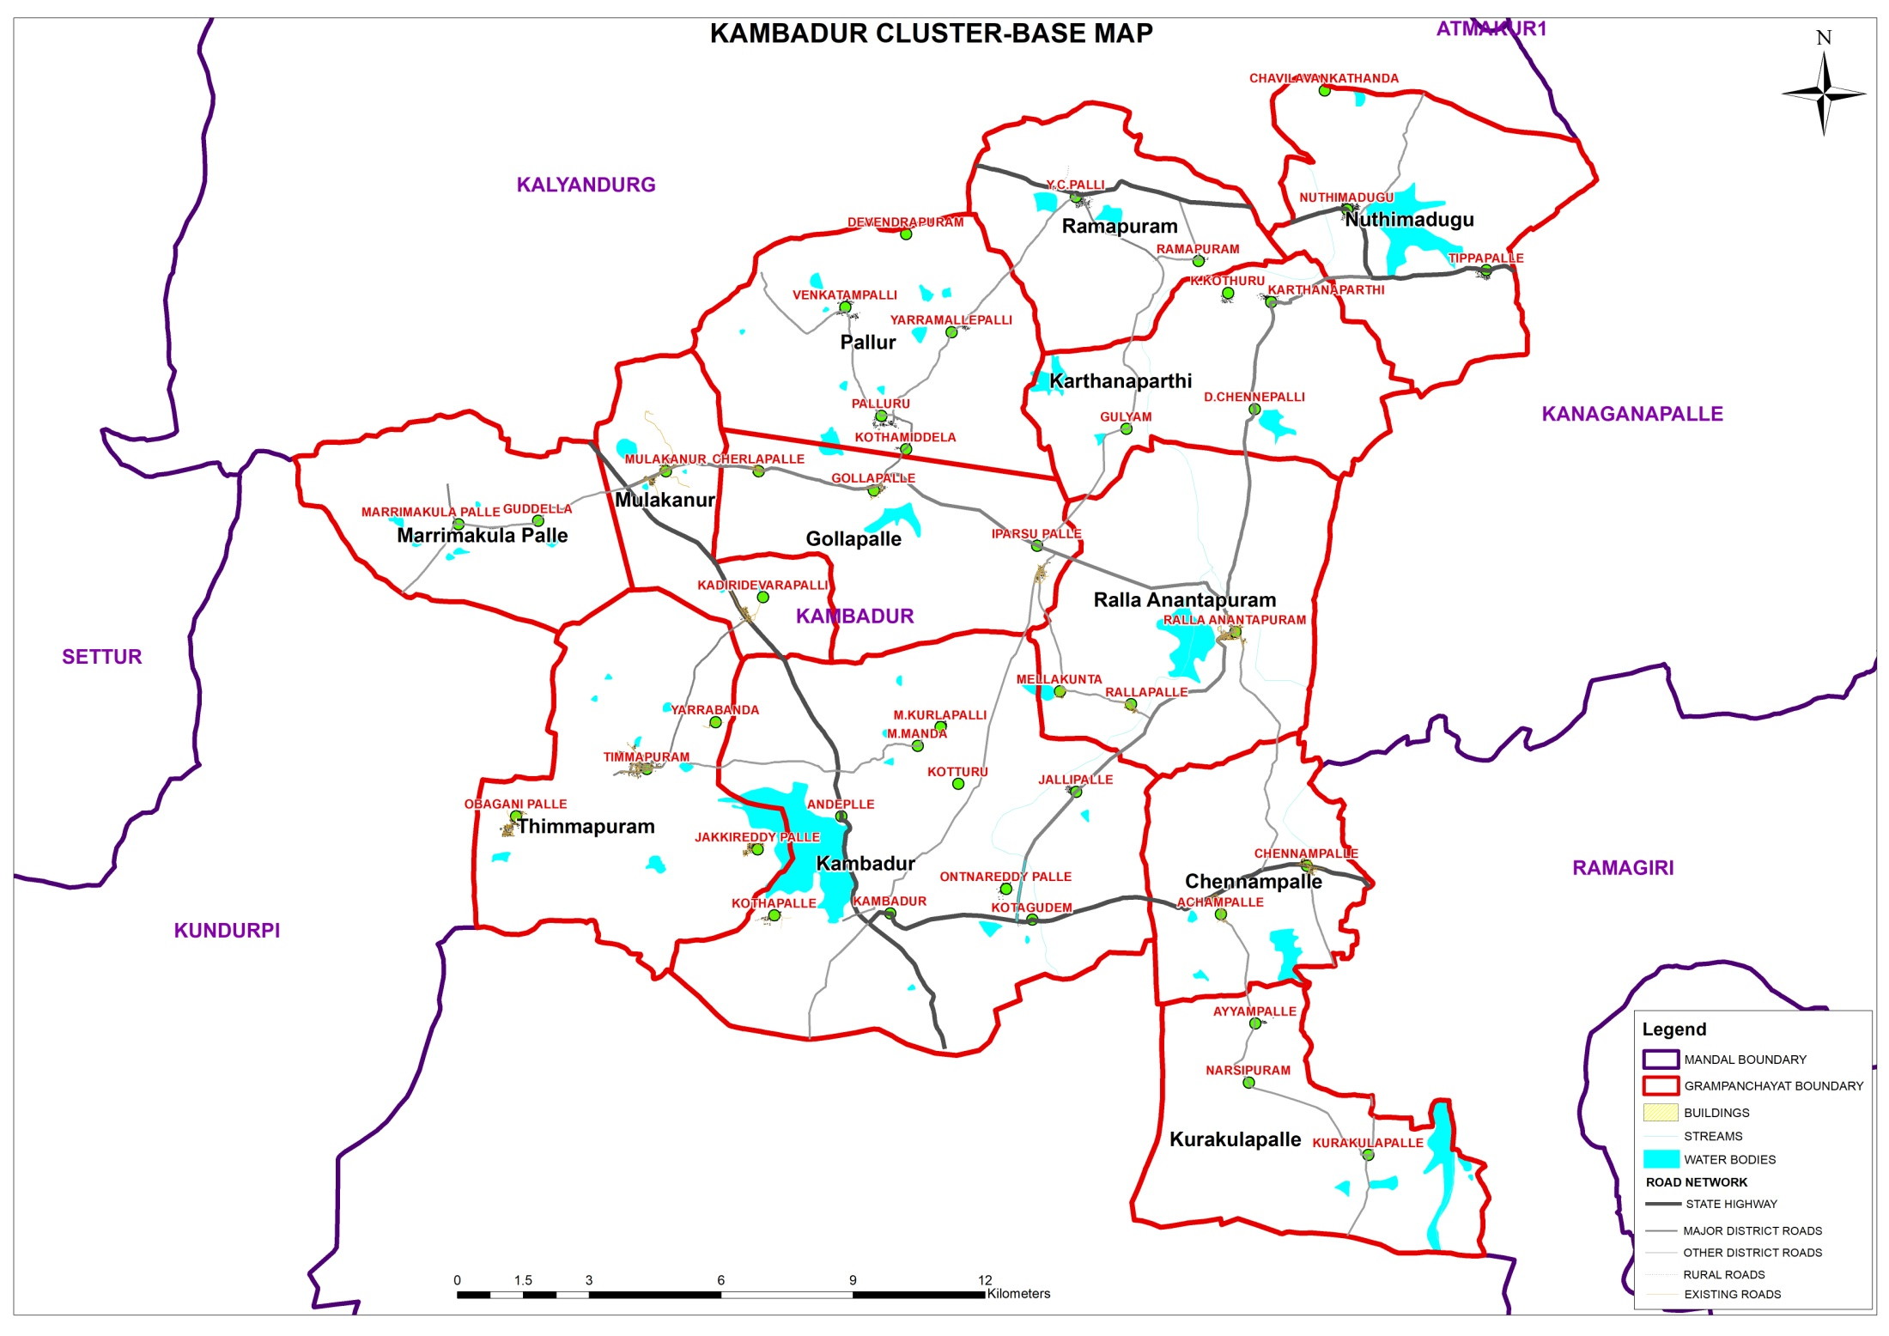

Slide 20
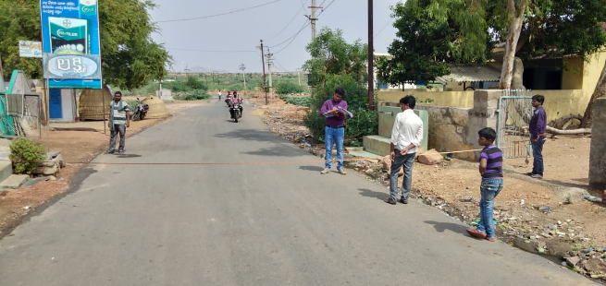
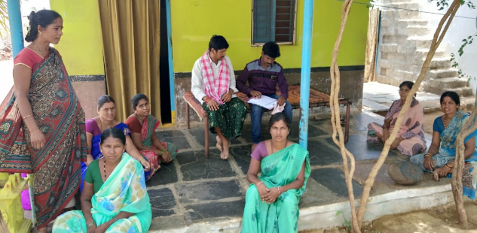
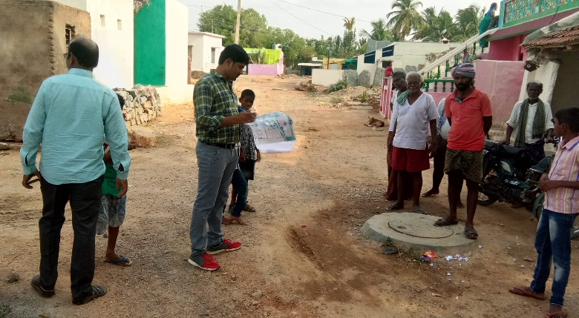
FIELD SURVEYS CARRIED OUT IN KAMBADUR CLUSTER
Road Inventory- Nuthimadugu
Household survey - C V Thanda
Landuse survey marking - Nuthimadugu
Household survey

Slide 21
EXISTING SITUATION ANALYSIS
Household size and no. of Households in 1991, 2001 and 2011
 | 1991 |  |  | 2001 |  |  | 2011 |  |  | Households
Villages | HH | POPLN | HH Size | HH | POPLN | HH Size | HH | POPLN | HH Size | Total | Good | Livable | Dilapidated
CHENNAMPALLE | 354 | 1958 | 5.5 | 462 | 2200 | 4.8 | 602 | 2521 | 4.2 | 602 | 539 | 57 | 5
GULYAM | 135 | 599 | 4.4 | 145 | 755 | 5.2 | 205 | 909 | 4.4 | 205 | 200 | 5 | 0
KAMBADUR | 2174 | 11564 | 5.3 | 2786 | 13520 | 4.9 | 3407 | 15441 | 4.5 | 3407 | 2180 | 1097 | 129
KARTHANAPARTHI | 291 | 1773 | 6.1 | 469 | 2240 | 4.8 | 564 | 2459 | 4.4 | 564 | 453 | 103 | 7
KURAKULAPALLE | 340 | 2216 | 6.5 | 526 | 2531 | 4.8 | 678 | 2838 | 4.2 | 678 | 574 | 92 | 13
MULAKANUR | 740 | 3944 | 5.3 | 1029 | 4874 | 4.7 | 1245 | 5622 | 4.5 | 1245 | 1002 | 195 | 47
NUTHIMADUGU | 620 | 3202 | 5.2 | 849 | 3836 | 4.5 | 974 | 3897 | 4.0 | 974 | 842 | 87 | 46
PALLUR | 861 | 4813 | 5.6 | 1088 | 5418 | 5.0 | 1369 | 5877 | 4.3 | 1369 | 964 | 367 | 40
RALLAANANTAPURAM | 284 | 1528 | 5.4 | 392 | 1838 | 4.7 | 501 | 2147 | 4.3 | 501 | 431 | 70 | 0
RALLAPALLE | 140 | 851 | 6.1 | 224 | 1192 | 5.3 | 307 | 1283 | 4.2 | 307 | 225 | 68 | 14
RAMAPURAM | 293 | 1532 | 5.2 | 421 | 2067 | 4.9 | 505 | 1972 | 3.9 | 505 | 424 | 63 | 18
THIMMAPURAM | 850 | 4692 | 5.5 | 1131 | 6269 | 5.5 | 1311 | 5833 | 4.4 | 1311 | 1000 | 207 | 105
Total | 7082 | 38672 | 5.5 | 9522 | 46740 | 4.9 | 11668 | 50799 | 4.3 | 11668 | 8835 | 2412 | 424
It is observed that household size has been reduced from 5.5 to 4.3 from 1991 to 2011.
Out of total 11668 HH, 424 HH live in dilapidated condition.
Source: Census of India, 2011, 2001 & 1991

Slide 22
Work force
Total Population - 50799
Total Workers (Main+ Marginal) - 26729
Main Workers | 19766
Marginal Workers | 6963
Non Workers | 24070
Cultivators | 7437
Agriculture Labrourers | 14352
Household Industrial Workers | 1129
Other Workers | 3811
Source: Census of India, 2011, 2001 & 1991

Slide 23
EXISTING SITUATION ANALYSIS - HOUSING
Source: Primary Survey
As per primary survey analysis, it is observed that most of the people are benefited through Govt schemes.
65% of people are benefited through Indiramma hosing scheme

Slide 24
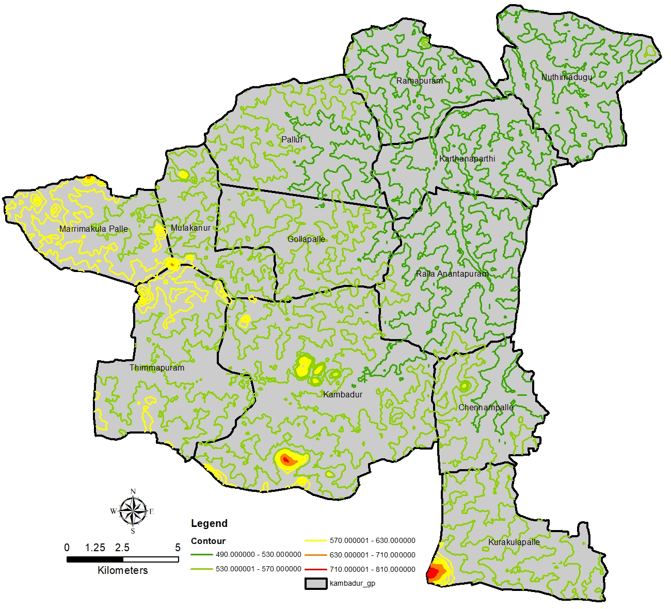
EXISTING SITUATION ANALYSIS – Contour Map
30
20
20
05
08
20
30
60
PF
20
Source: SRTM DATA- USGS
24

Slide 25
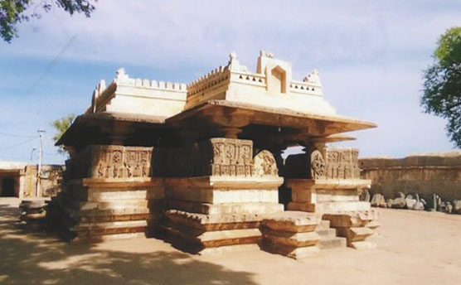
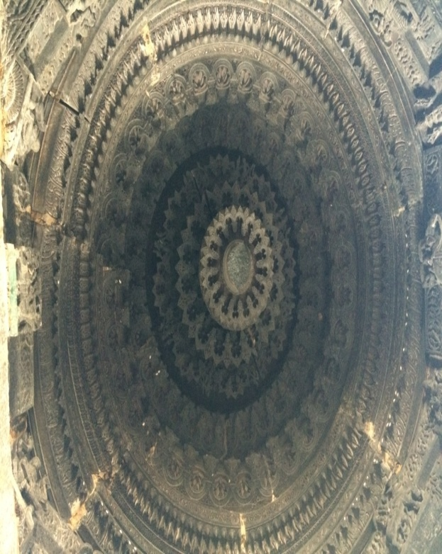
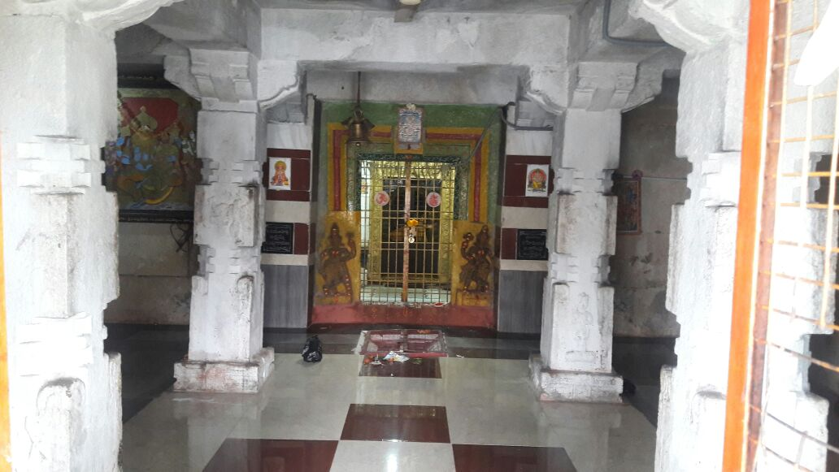
EXISTING SITUATION ANALYSIS - HERITAGE SITES
MALLESWARA SWAMY (SIVA) TEMPLE at Kambadur – 8th century
Chalukyan style of Architecture, plan detail outs Garbhagriha, Antarala, Rangamandapas and open Mukhamandapa
East Face entrance (8th century)
The central ceiling
Sri Lakshmi Narasimha Swamy Temple at Thimmapuram – 15th century
Both temples has historical prominence and it is observed that they are not notified under ASI or State Archaeology. Further it is also observed that the restoration of temples is not done in traditional way and essence of Architecture style is diluted.

Slide 26
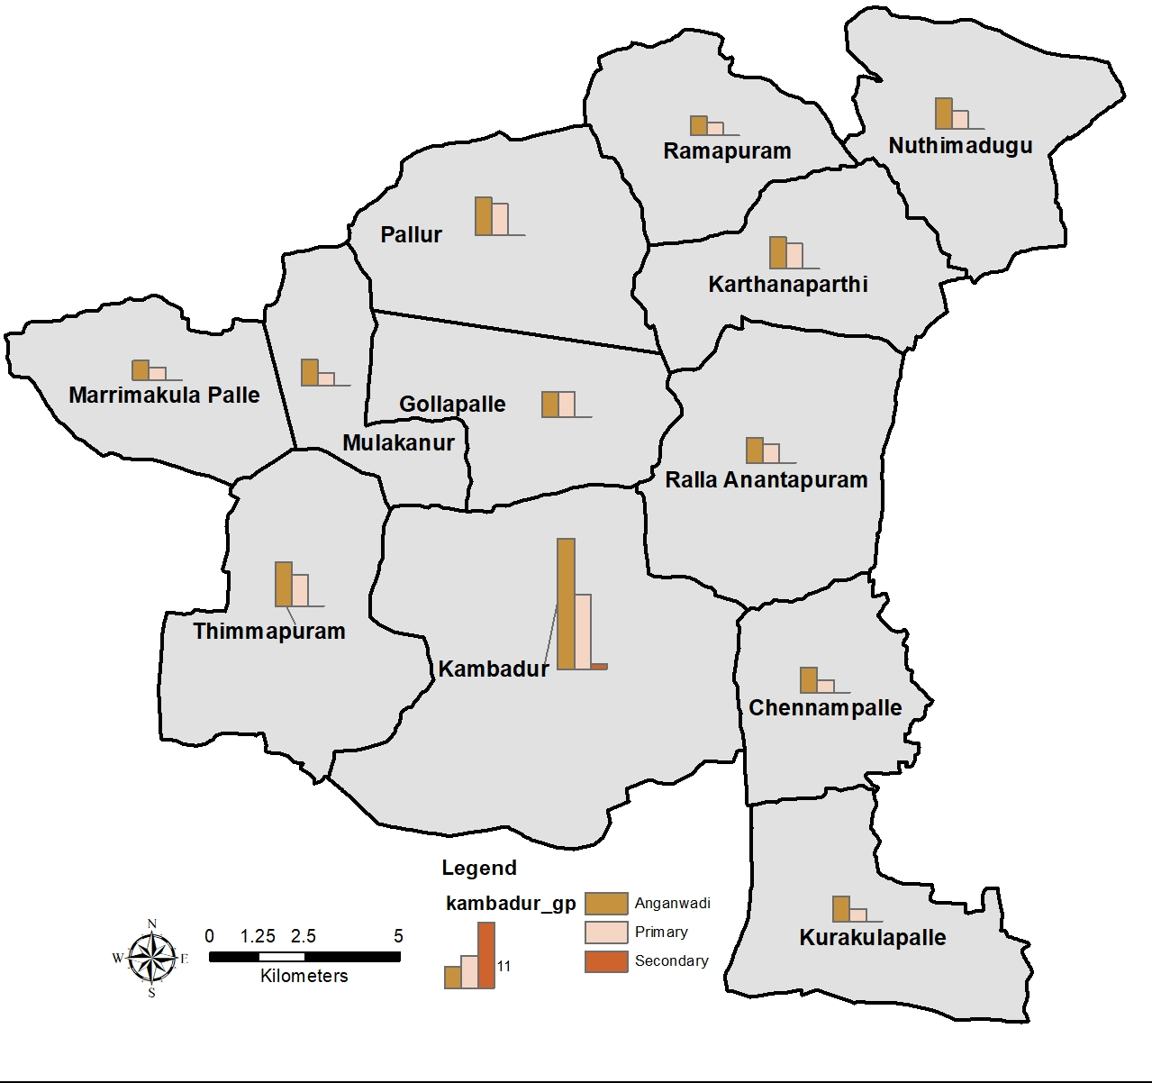
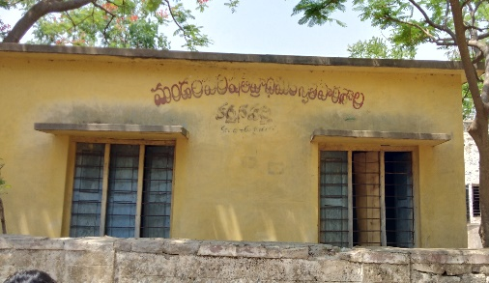
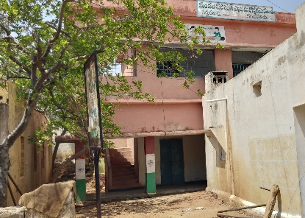
EXISTING SITUATION ANALYSIS - EDUCATION
GP name | Anganwadi | Primary | Secondary
Chennam palli | 4 | 2 | 0
Gollapalli | 4 | 4 | 0
Kambadur | 21 | 12 | 1
Karthana parthi | 5 | 4 | 0
Kurakulapalli | 4 | 2 | 0
Marrima kulapalli | 3 | 2 | 0
Mulkanur | 4 | 2 | 0
Nuthi madugu | 5 | 3 | 0
Palluru | 6 | 5 | 0
Ralla Ananthapuram | 4 | 3 | 0
Rama puram | 3 | 2 | 0
Thimma puram | 7 | 5 | 0
1
1
2
2
Among 12 Gram panchayat secondary education facility is available only at Kambadur GP.
Through primary analysis it is observed that for education purposes people travel 26kms to kalyanadurgam and 75.6 kms to Anantapur
Source: Census of India, 2011

Slide 27
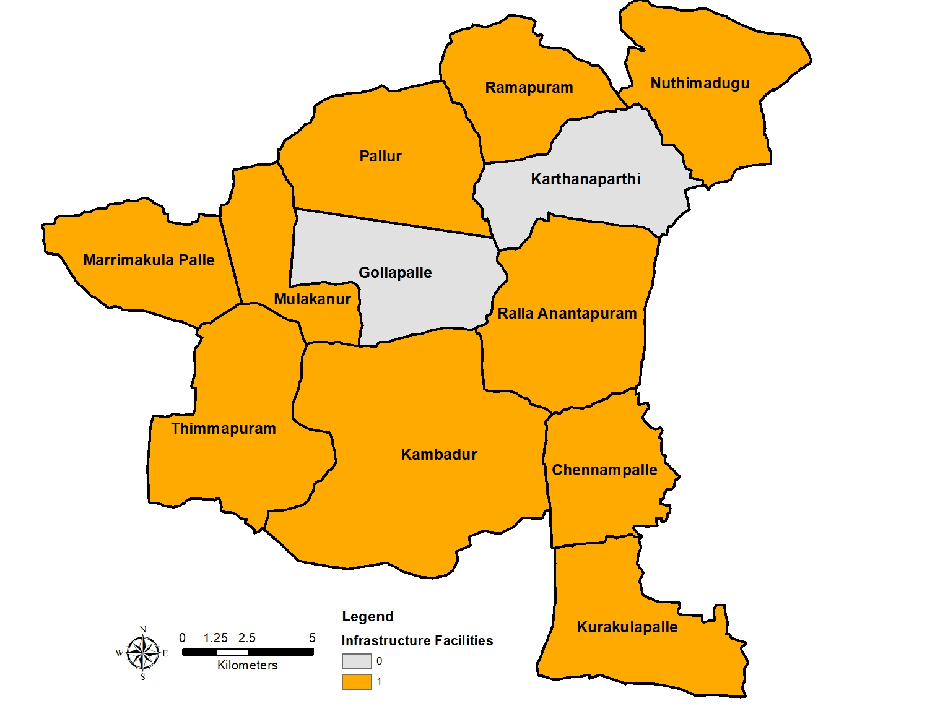
EXISTING SITUATION ANALYSIS - DISPENSARY
Dispensary facilities are not available at karthanaparthi and Gollapalle Gram Panchayats.
Source: Census of India, 2011

Slide 28
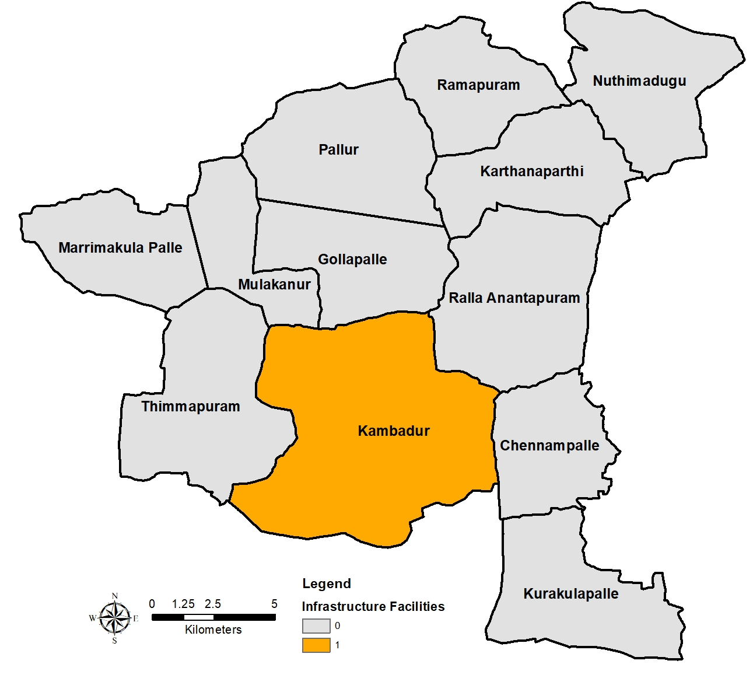
EXISTING SITUATION ANALYSIS – PRIMARY HEALTH CENTRES
Primary Health Center is available only in Kambadur.
Source: Census of India, 2011

Slide 29
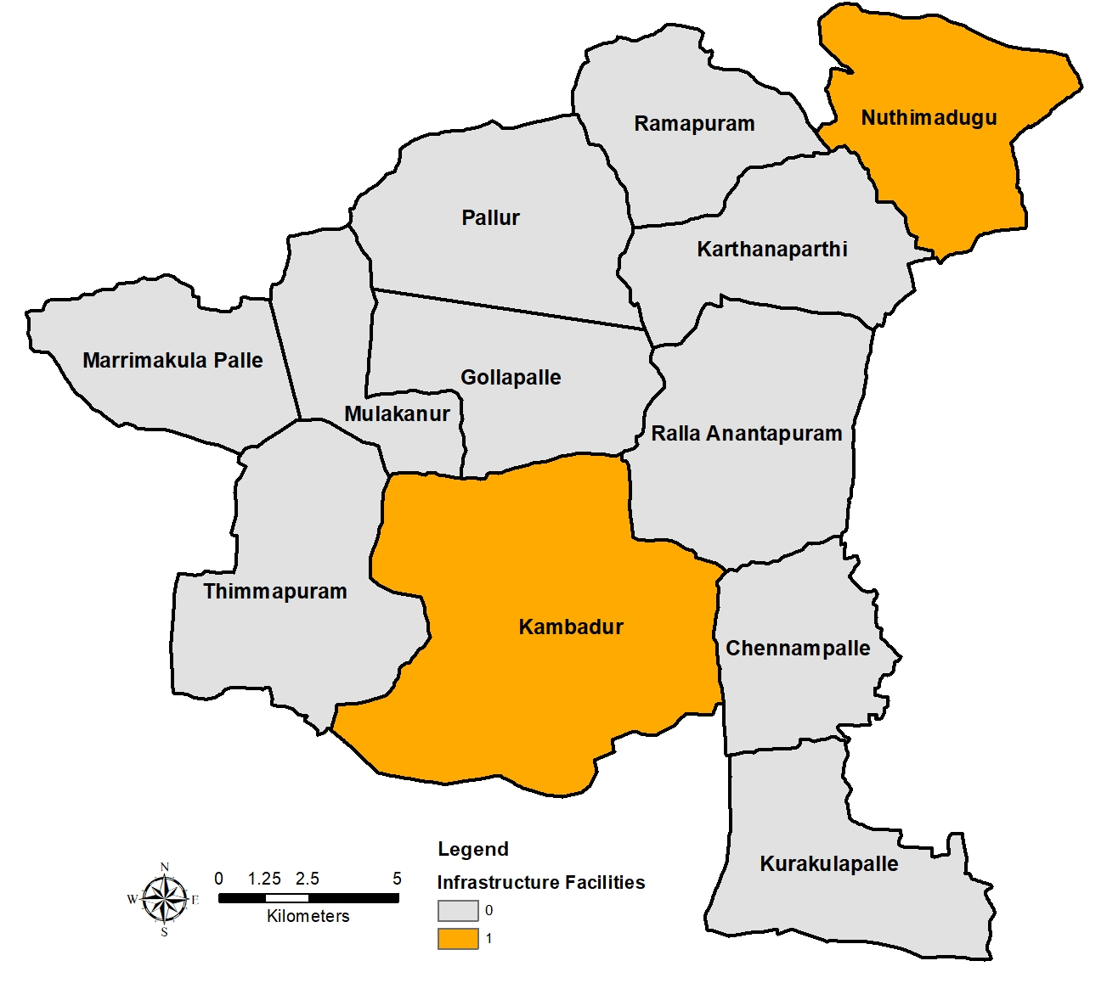
EXISTING SITUATION ANALYSIS - VETERINARY CENTERS
Veterinary centers are available only in Kambadur and Nuthimadugu
Source: Census of India, 2011

Slide 30
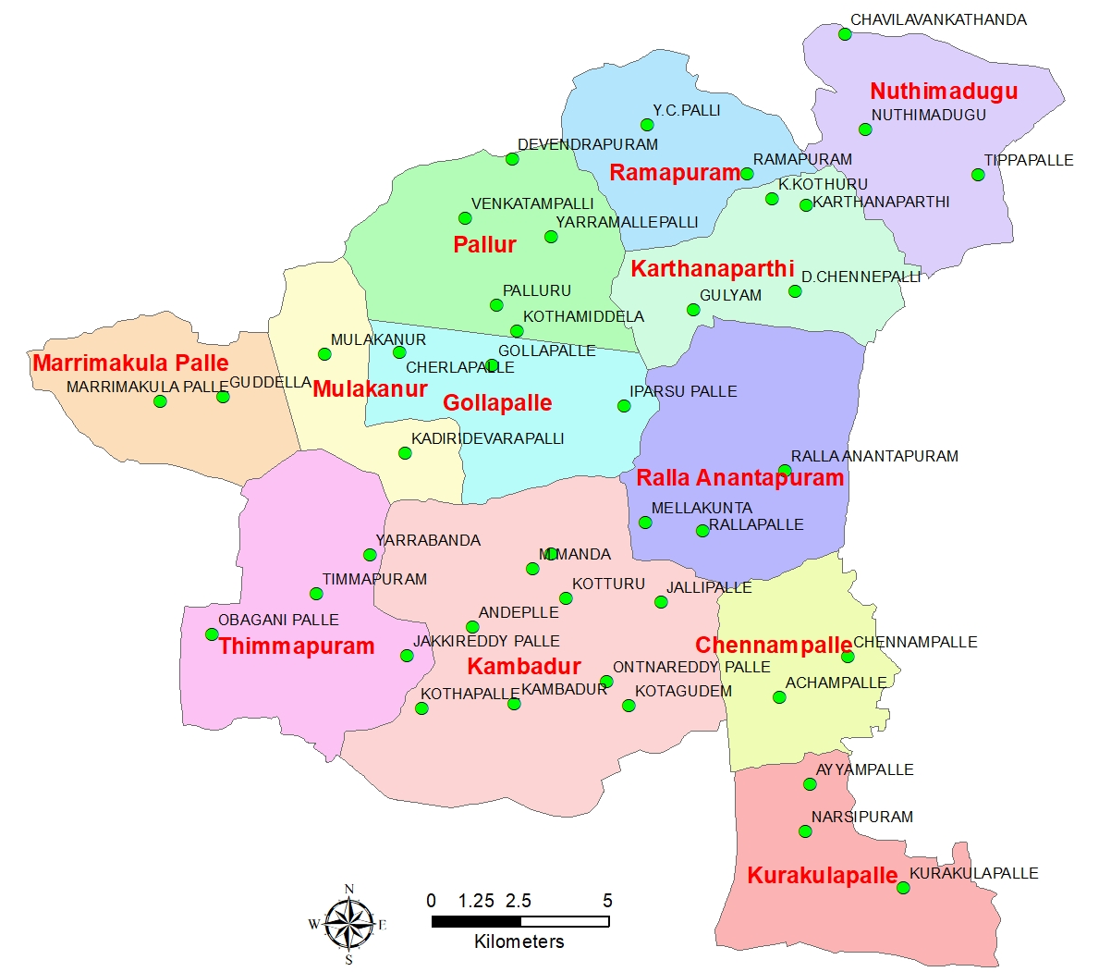
SATISFACTORY LEVELS ON INFRASTRUCTURE
Source: Primary Survey

Slide 31
SATISFACTORY LEVELS ON INFRASTRUCTURE
Water supply
Sewerage System
GRAM PANCHAYAT | GOOD | AVERAGE | POOR
CHENNAMPALLI | 40 | 60 | 0
GOLLAPALLI | 8 | 31 | 62
KAMBADUR | 24 | 14 | 62
KARTHANAPARTHI | 11 | 5 | 79
KURAKULAPALLI | 15 | 0 | 85
MARRIMAKURAPALLI | 10 | 20 | 70
MULKANUR | 57 | 14 | 29
NUTHIMADUGU | 8 | 25 | 67
PALLURU | 33 | 8 | 58
RALLA ANANTHAPURAM | 50 | 17 | 33
RAMPURAM | 0 | 38 | 63
TIMMAPURAM | 11 | 11 | 78
GRAM PANCHAYAT | GOOD | AVERAGE | POOR
CHENNAMPALLI | 20 | 0 | 80
GOLLAPALLI | 0 | 0 | 100
KAMBADUR | 3 | 10 | 86
KARTHANAPARTHI | 0 | 0 | 100
Kurakulapalli | 69 | 8 | 23
MARRIMAKURAPALLI | 0 | 0 | 100
MULKANUR | 14 | 0 | 86
NUTHIMADUGU | 42 | 8 | 50
PALLURU | 8 | 0 | 92
RALLA ANANTHAPURAM | 33 | 11 | 56
RAMPURAM | 0 | 0 | 100
TIMMAPURAM | 11 | 0 | 89
Source: Primary Survey

Slide 32
SATISFACTORY LEVELS ON INFRASTRUCTURE
Electricity
Street Lighting
GRAM PANCHAYAT | GOOD | AVERAGE | POOR
CHENNAMPALLI | 80 | 20 | 0
GOLLAPALLI | 100 | 0 | 0
KAMBADUR | 93 | 0 | 7
KARTHANAPARTHI | 95 | 0 | 5
KURAKULAPALLI | 100 | 0 | 0
MARRIMAKURAPALLI | 100 | 0 | 0
MULKANUR | 100 | 0 | 0
NUTHIMADUGU | 75 | 0 | 17
PALLURU | 100 | 0 | 0
RALLA ANANTHAPURAM | 94 | 6 | 0
RAMPURAM | 100 | 0 | 0
TIMMAPURAM | 94 | 6 | 0
GRAM PANCHAYAT | GOOD | AVERAGE | POOR
CHENNAMPALLI | 80 | 20 | 0
GOLLAPALLI | 31 | 38 | 31
KAMBADUR | 41 | 24 | 34
KARTHANAPARTHI | 84 | 16 | 0
KURAKULAPALLI | 77 | 8 | 15
MARRIMAKURAPALLI | 10 | 50 | 40
MULKANUR | 71 | 29 | 0
NUTHIMADUGU | 58 | 17 | 25
PALLURU | 75 | 17 | 8
RALLA ANANTHAPURAM | 67 | 28 | 6
RAMPURAM | 88 | 13 | 0
TIMMAPURAM | 67 | 6 | 28
Source: Primary Survey

Slide 33
SATISFACTORY LEVELS ON INFRASTRUCTURE
Solid Waste Management
Pension
GRAM PANCHAYAT | GOOD | AVERAGE | POOR
CHENNAMPALLI | 20 | 0 | 80
GOLLAPALLI | 0 | 0 | 100
KAMBADUR | 7 | 0 | 93
KARTHANAPARTHI | 95 | 0 | 5
KURAKULAPALLI | 8 | 8 | 85
MARRIMAKURAPALLI | 40 | 0 | 60
MULKANUR | 71 | 14 | 14
NUTHIMADUGU | 67 | 8 | 25
PALLURU | 0 | 0 | 100
RALLA ANANTHAPURAM | 44 | 6 | 50
RAMPURAM | 63 | 0 | 38
TIMMAPURAM | 22 | 6 | 72
Types of Pension
Source: Primary Survey

Slide 34
DEMOGRAPHIC ANALYSIS & PROJECTIONS
Linear and Geometric Projections of Population for Kambadur Cluster -2041
Gram Panchayat | 1991 | 2001 | 2011 | Linear Projection |  |  |  | Geometric Projection
 |  |  |  | GR 2001-2011 | 2021 | 2031 | 2041 | GR 2001-2011 | 2021 | 2031 | 2041
Chennampalle | 1958 | 2200 | 2521 | 0.15 | 2889 | 3257 | 3625 | 0.14 | 2889 | 3310 | 3793
Gulyam | 599 | 755 | 909 | 0.20 | 1094 | 1280 | 1465 | 0.19 | 1094 | 1318 | 1586
Kambadur | 11564 | 13520 | 15441 | 0.14 | 17635 | 19829 | 22023 | 0.13 | 17635 | 20141 | 23002
Karthanaparthi | 1773 | 2240 | 2459 | 0.10 | 2699 | 2940 | 3180 | 0.09 | 2699 | 2963 | 3253
Kurakulapalle | 2216 | 2531 | 2838 | 0.12 | 3182 | 3526 | 3871 | 0.11 | 3182 | 3568 | 4001
Mulakanur | 3944 | 4874 | 5622 | 0.15 | 6485 | 7348 | 8210 | 0.14 | 6485 | 7480 | 8628
Nuthimadugu | 3202 | 3836 | 3897 | 0.02 | 3959 | 4021 | 4083 | 0.02 | 3959 | 4022 | 4086
Pallur | 4813 | 5418 | 5877 | 0.08 | 6375 | 6873 | 7371 | 0.08 | 6375 | 6915 | 7501
Ralla Anantapuram | 1528 | 1838 | 2147 | 0.17 | 2508 | 2869 | 3230 | 0.16 | 2508 | 2930 | 3422
Rallapalle | 851 | 1192 | 1283 | 0.08 | 1381 | 1479 | 1577 | 0.07 | 1381 | 1486 | 1600
Ramapuram | 1532 | 2067 | 1972 | -0.05 | 1881 | 1791 | 1700 | -0.05 | 1881 | 1795 | 1712
Thimmapuram | 4692 | 6269 | 5833 | -0.07 | 5427 | 5022 | 4616 | -0.07 | 5427 | 5050 | 4699
Total | 38672 | 46740 | 50799 | 0.08 | 55515 | 60235 | 64951 | 0.08 | 55515 | 60978 | 67283
Source: Census of India, 2011, 2001 & 1991

Slide 35
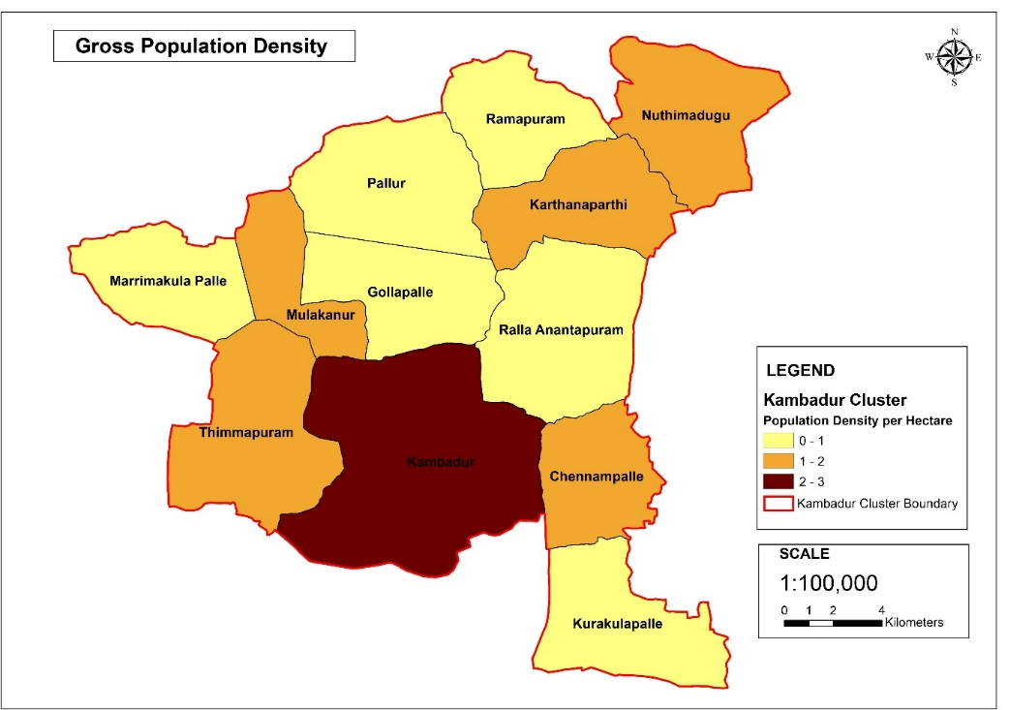
Demographic Analysis & Projections
The density of population is more in Kambadur when compared to other GP’s.
The Kambadur cluster expected to accommodate 67,283 total population by 2041 as per geometric method
Source: Census of India, 2011, 2001 & 1991

Slide 36
Spatial Plan
Draft Perspective Cluster Master Plan
Proposed Land Use
Zoning Regulation
Under Process

Slide 37
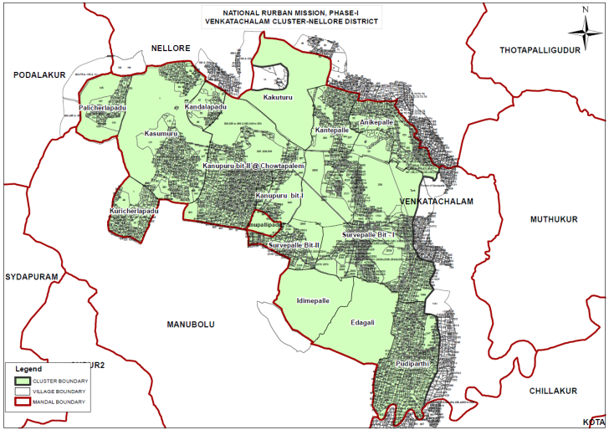
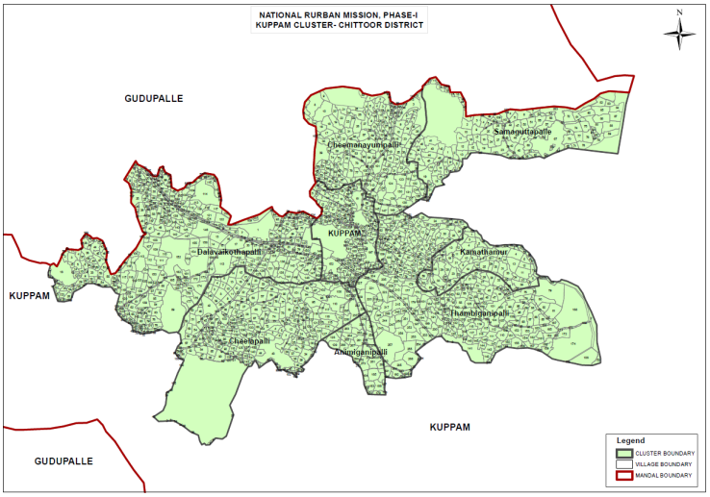
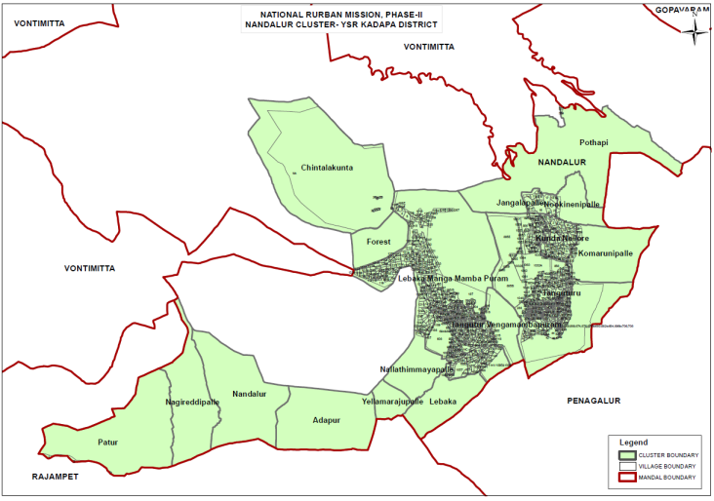
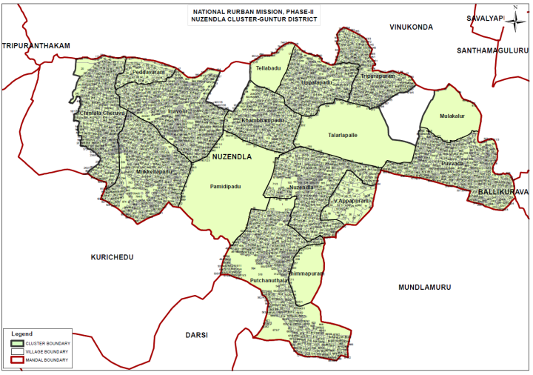
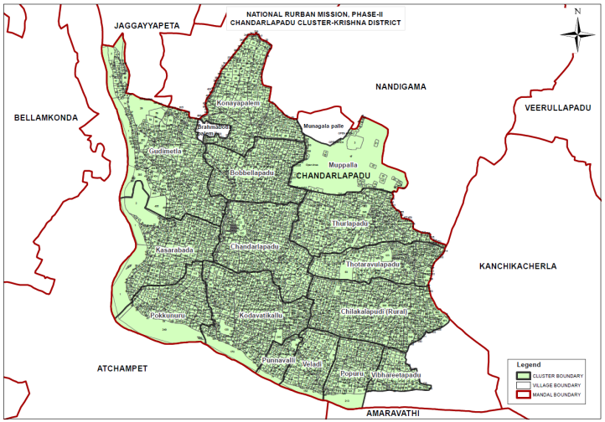
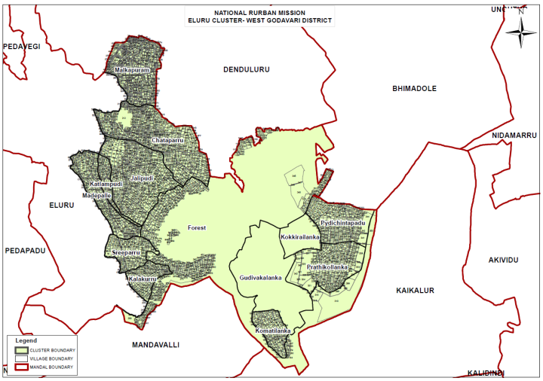
Issues & Recommendation
Issues related to :-
Planning Notification- yet to notify for 2 clusters Eluru and Rampachodavaram
Preparation of Existing Land Use – Delay in supply of Satellite images to DTCP.
Mismatch of Cadastral data.

Slide 38
THANK YOU……………………

